Slide 1
N B N Update
What ?
When ?
Cost ?
Dave Botherway August - 2017

Slide 2
National Broadband Network
Australia wide Network, using new Fibre Optic technology
to totally replace older Microwave (now Fibre ? ) and Copper network
Originally all FttP - Fibre to the Premises or (FttB), expensive
Compromise FttN - Fibre to the Node (in Street), or Fixed Radio
Takeover Telstra cable network, Replace Optus Cable !
Remote areas - new lower-cost Satellite access, subsidised ?
Recently announced - FttC (Curb) / FttDP (Distribution Point)

Slide 3
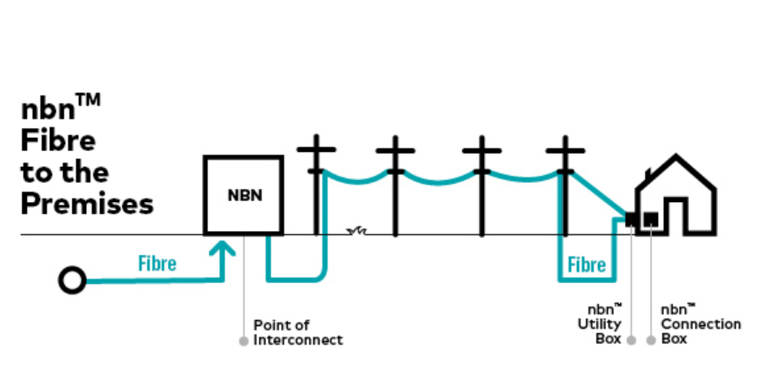
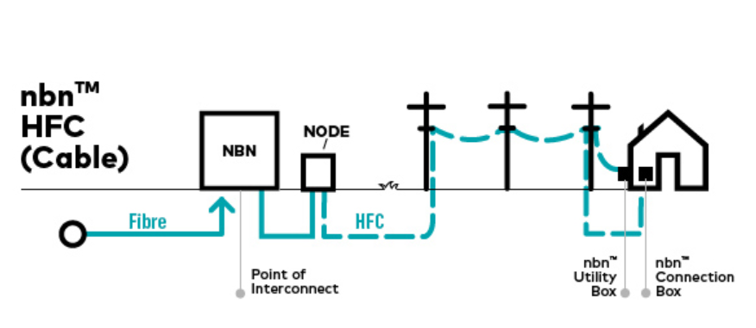
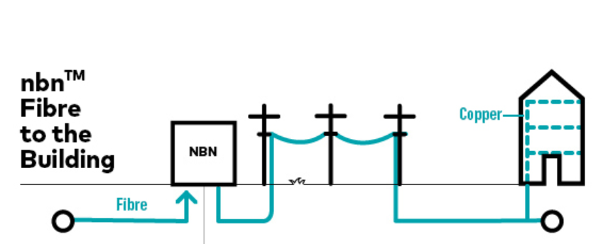
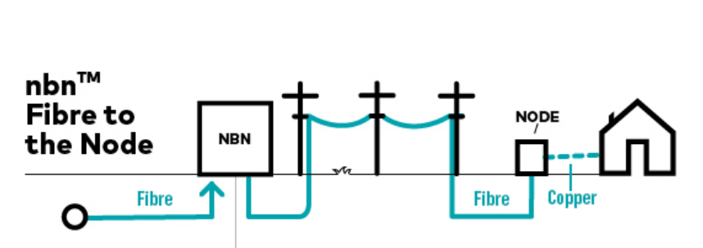
Method Summary
HFC shared
Fibre
Copper, dedicated

Slide 4
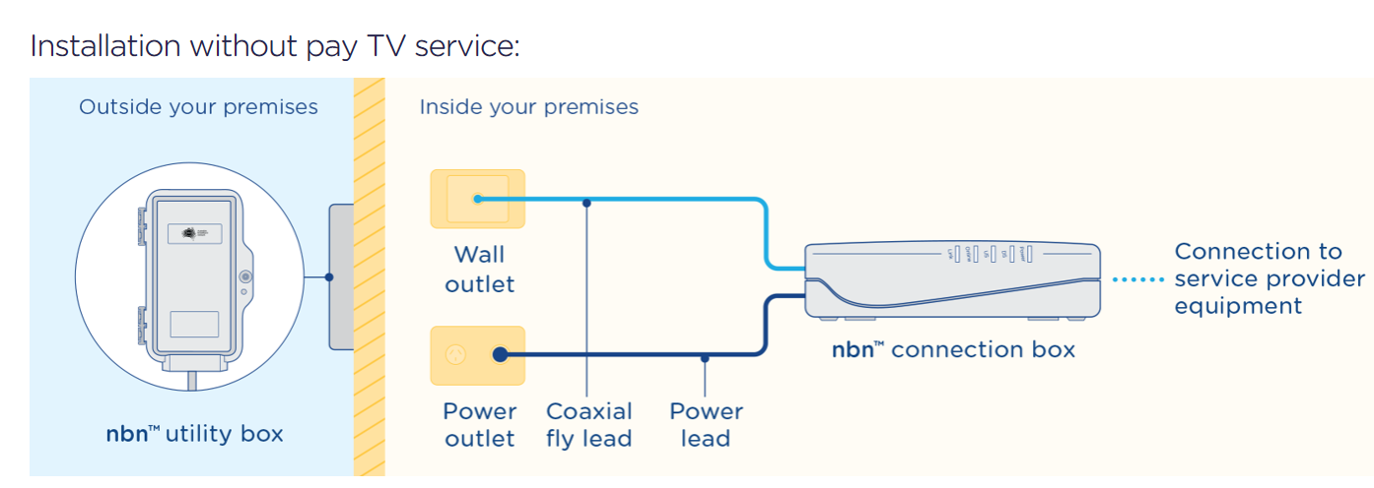
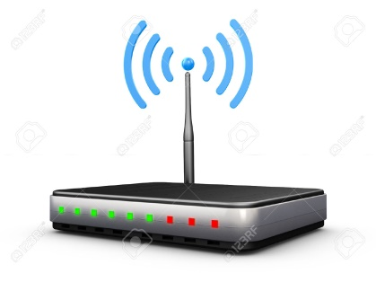
Hybrid Fibre Coax – ala Telstra/Optus cable
Router + WiFi
ex RSP

Slide 5
HFC – who does what ?
RSP Router
Retail Service Provider (RSP) to provide, unless BYO

Slide 6
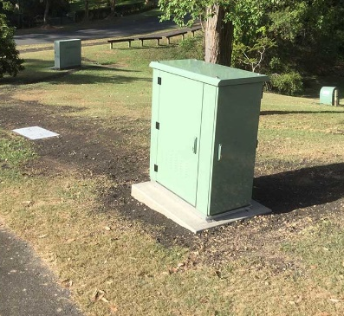
Fibre to Node (or Kerb) - for most people
Existing
Street Node
Different Modem - may have WiFi & Multi Ports To PCs etc
( negotiate with ISP . . . )

Slide 8
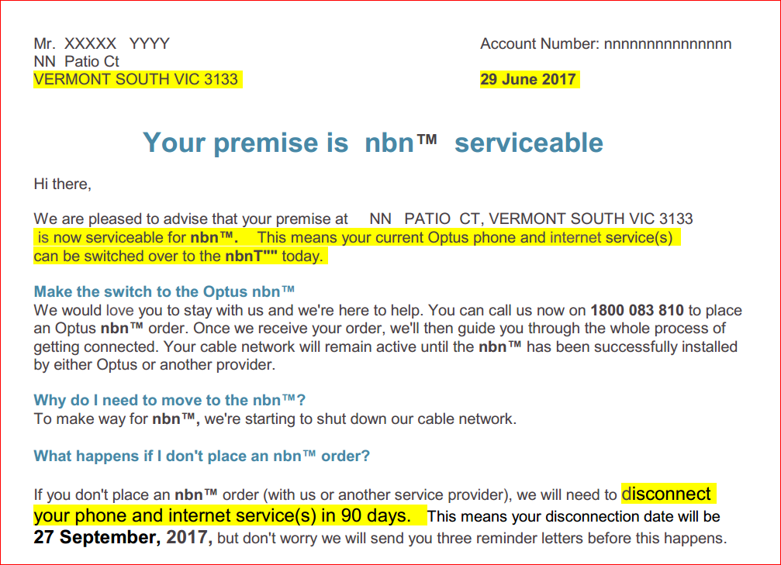
The
Optus
Letters

Slide 9
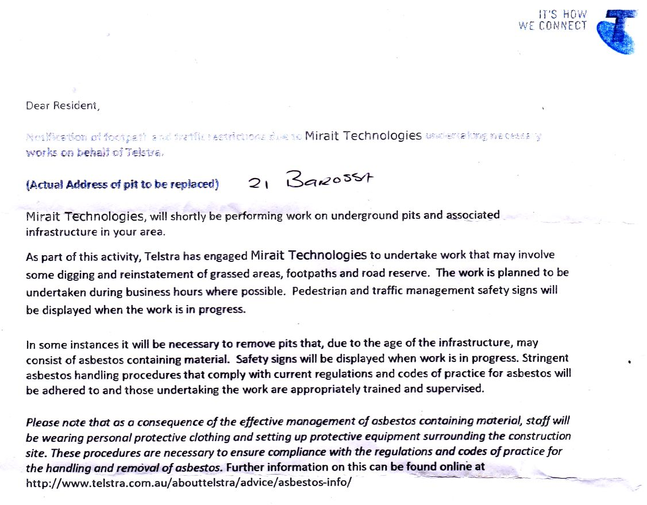
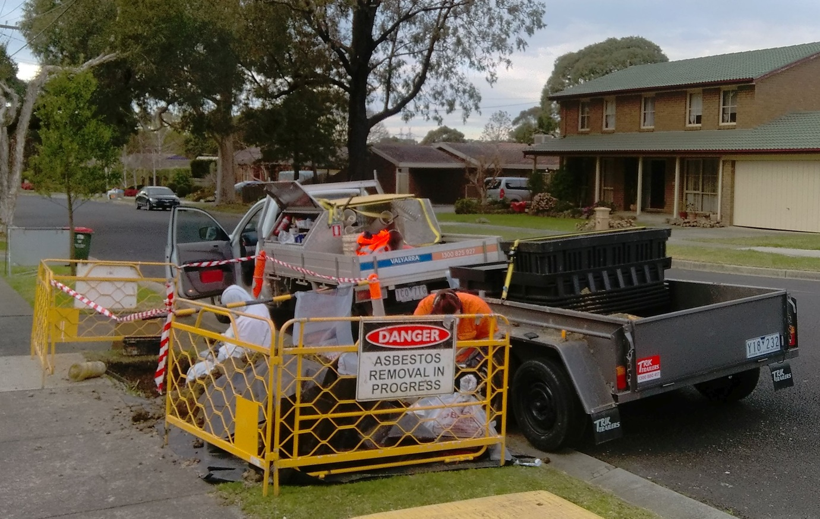
The saga
continues
On 8-August-17
14-August

Slide 10
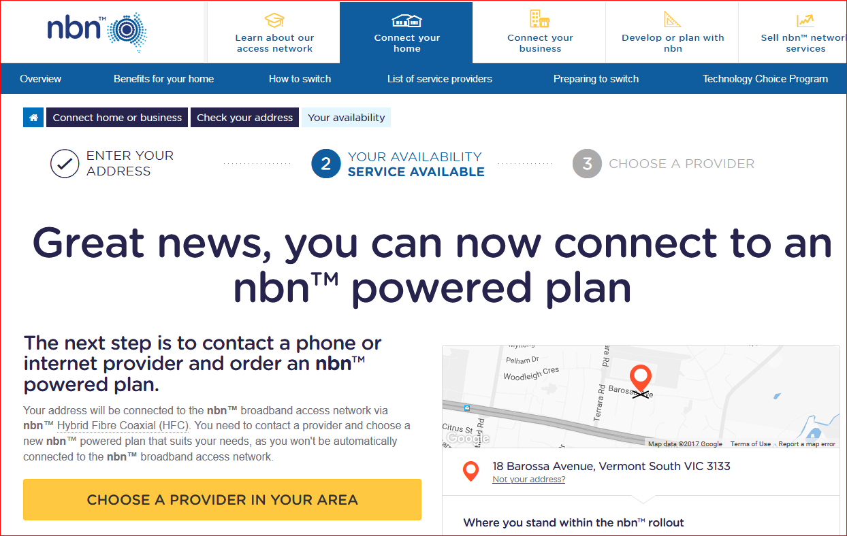
Finally, on 18-August-17

Slide 11
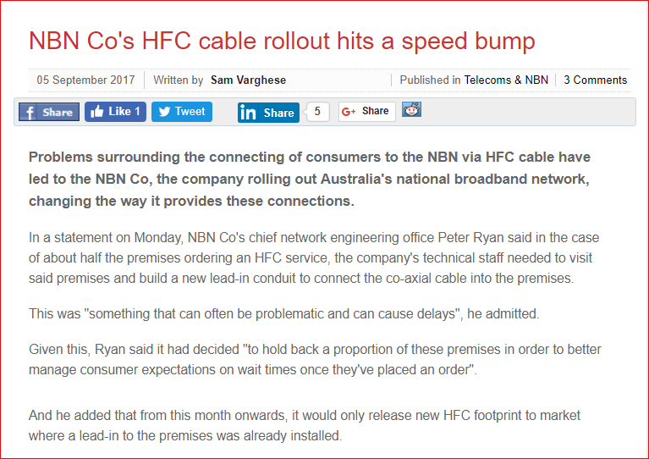

Slide 12
NBN - Choosing a Plan !
Dave-B ?
500 GB
50 Mbps
All AU
Maybe
12 m
Amount of data - 5 GB / month, up to Unlimited
Maximum Speed - 12 Mbps to 100 Mbps
Bundled Phone – Fixed Lines, Mobile, International
Entertainment Bundles - Foxtel, TelstraTV, FetchTV
Contract Period – Monthly, 12 months, 24 months

Slide 13
Optus Offering . . .
“ $80 Plan ” ( 25/5 Mbps, U/L Data, Fetch TV) $ 80 /m
Speed Upgrade to 100 / 40 Mbps $ 20 /m
Local and Mobile Calls ( excludes 13, 1300) $ 10 /m
International calls ( to 25 countries ) $ 10 /m --------------
$ 120 /m
However, currently (nearly same functions) for $ 81 /m - to be negotiated !

Slide 14
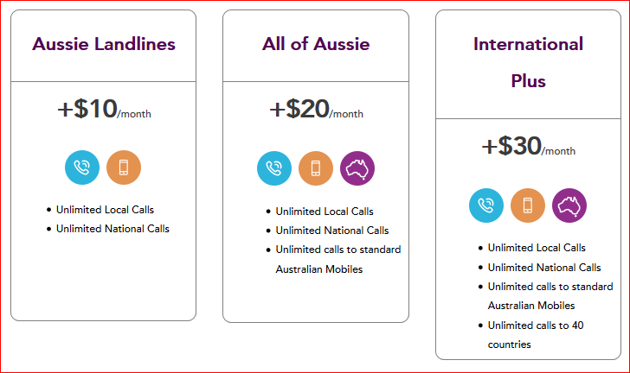
Optus = $120 !
100 Mbps + Calls = $90/m,

Slide 15
Summary
NBN is coming – like it or not !
Will replace existing “wired” system (unless -> all mobile)
Check NBN site to find dates & method for your address
Decide on your own requirements
Explore various ISPs – and negotiate . . . . .

Slide 16
Questions

