Slide 1
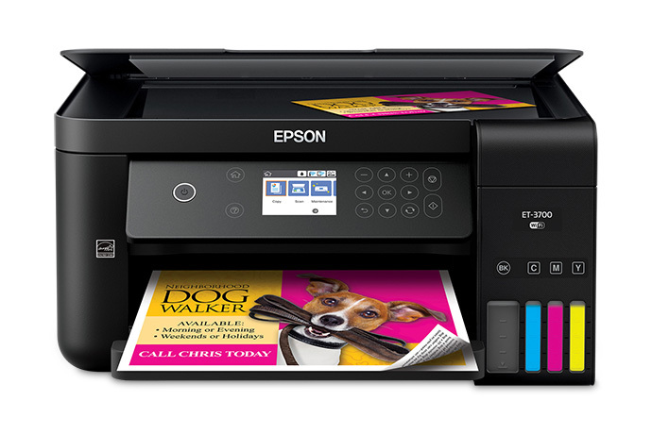
EPSON EXPRESSION
ET – 3700 ECOTANK
MULTIFUNCTION PRINTER
Multi Media – 2.2.18
David King

Slide 2
What Attracted Me?
Positive Review in Feb. “PC & TECH AUTHORITY”.
Ink included for 2 Years Printing.
14,000 pages black/11,000 colour, (equiv. ca 30 ink cartridge sets).
Supports Apple AirPrint and Google Cloud.
Built–in wireless, Wi Fi Direct & Ethernet.
2 Year warranty

Slide 3
Apple AirPrint

Slide 4
Specs.
Printer, Scanner & Photocopier.
4800 x 1200 DPI printing.
15 ppm black.
8 ppm colour.
150 page A4 tray.
Automatic duplexer.
Flatbed 1200 x 2400 DPI A4 colour scanner.
2.4-inch colour front LCD.
4 Colour only (Not Photo Printer).

Slide 5
Price
Printer:
Office Works: $ 496.00 (as paid)
Epson Web Site: $ 549.00
US Amazon Web Site: $ US 329.99 ($50 discount on List).

Slide 6
Ink in the Box

Slide 7
A Modest 1’50”Video

Slide 8
Running Costs
Replacement Ink Bottles (Epson Web Site):
1x Black: $30.00 (Capacity 7500 sheets)
3x Colour: $45.00 (Capacity 6000 sheets)
Ink Cost per Sheet:
Black 0.4c., Colour 0.75c.

Slide 9
Comments/Questions?

