Slide 1
Master or Slave ?
. . Email . .
Beast SIG February-2019 Dave Botherway

Slide 2
Email Categories
Critical - cannot afford to lose, irreplaceable Ensure multiple backups exist, maybe also saved as PDFs
Important - with difficulty, can get “resends” eg. Tax Statements, Key family messages
Chit-Chat - Time expiring (say 2 weeks) eg. Coffee get together next week, weather discussions
S P A M - Unsolicited Messages, local Junk Folder If not blocked by email ISP
Blocked - Blocked by ISP May contain occasional key email message . . . . Check and access via Web Mail Caution – possible viruses . . .

Slide 3


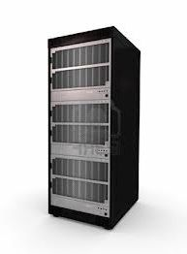


E-Mail - Client or Browser Access ?
Web Mail,
via Browsers
Outlook.com Server
Web Browser Access
Incoming e-Mail
UserID= abc@melbpc.org.au
abc @ melbpc.org.au
Client Download
For UserID= abc@melbpc.org.au
Client = Windows Mail, Office Outlook, Eudora, Thunderbird etc

Slide 4
Key Steps
Have separate folders for key subject types
Have rules setup to move emails to appropriate folders, as received
Minimise ‘Unread’ messages in Inbox and other folders . . . Read and file elsewhere - else delete . . .
Where rules inapplicable, move manually to needed folder
Delete messages not needed (e.g. read receipts ?)
Delete S P A M, maybe black list sender . . .
Check local Junk folder, maybe White list sender . . .
Occasionally check ISP blocked messages – may need to advise OK

Slide 5
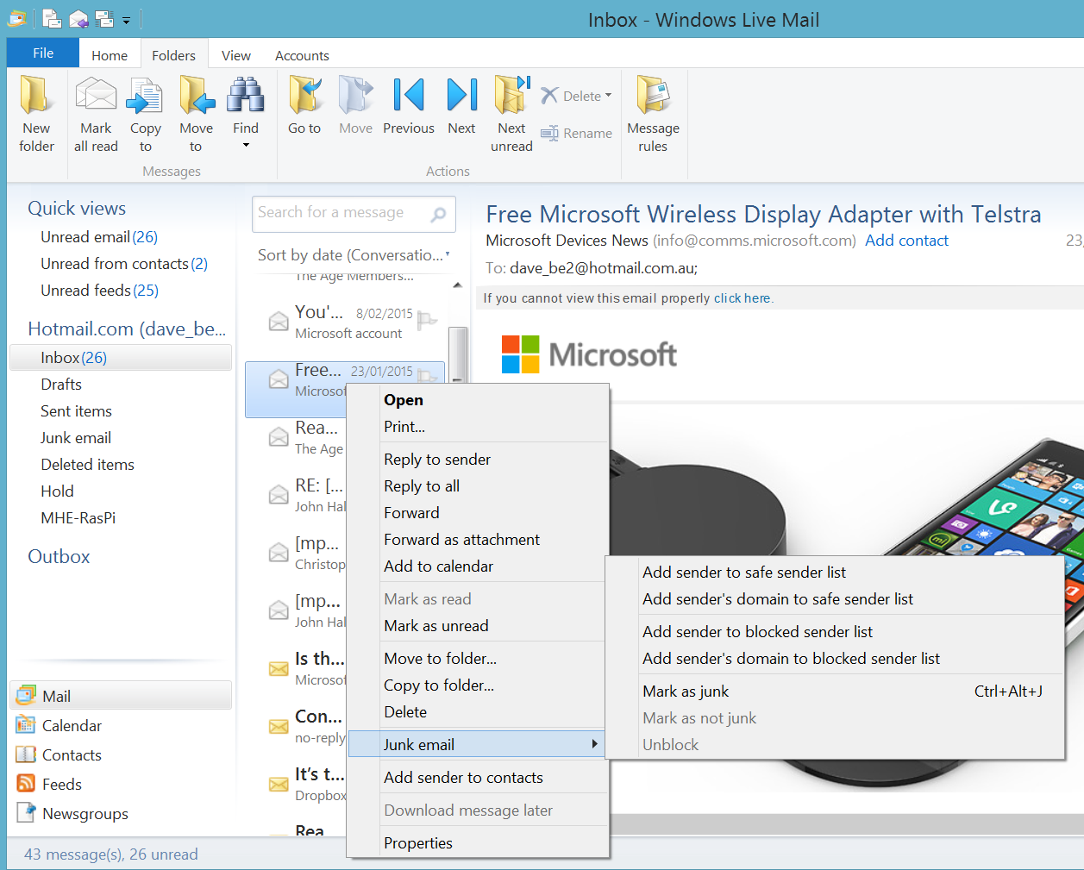
Win Live Mail
Blocking Senders 1
Open Win Live Mail – select a problem email, Right Click
then Select Junk Email
Click – Add sender (or their domain) to blocked sender list

Slide 6
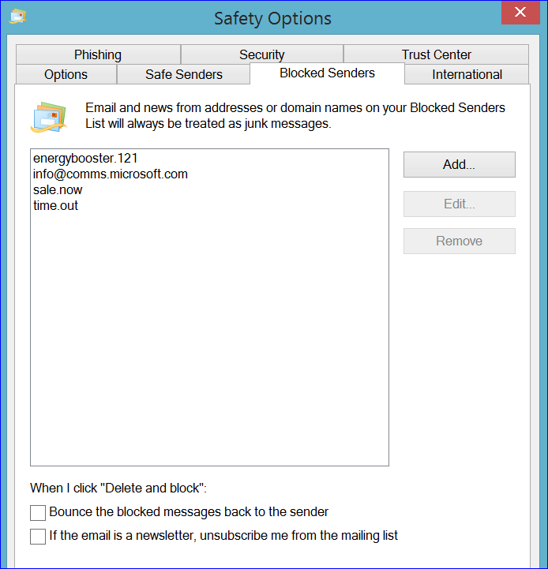
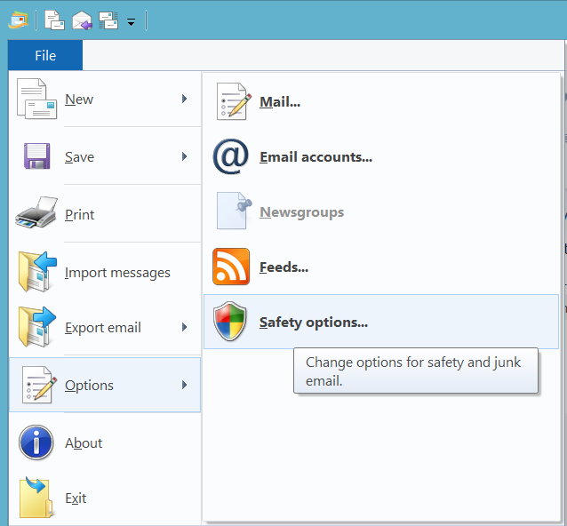
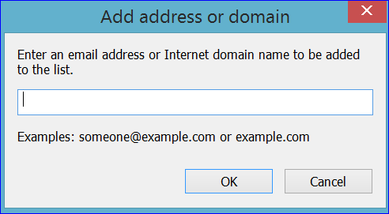
Win Live Mail:
Blocking Senders 2
Open Win Live Mail – then File, Options, Safety
then Blocked Senders tab
Click – Add button
and add address
Note – Bounce and
Unsubscribe options

Slide 7
Email Rules – Examples
NOTE - Rules can be used at Email-ISP and/or PC-Client
If Subject is Dividend, move to Shares Folder
If Sender or Receiver is ‘ato.gov.au’, move to Tax Folder
If any Header = SES, move to SES folder NB. Mistakenly picks up subject “advice for 60-pluses”
If Sender is YYY, move to Junk Folder
If Sender is ZZZ, delete immediately

