Slide 1
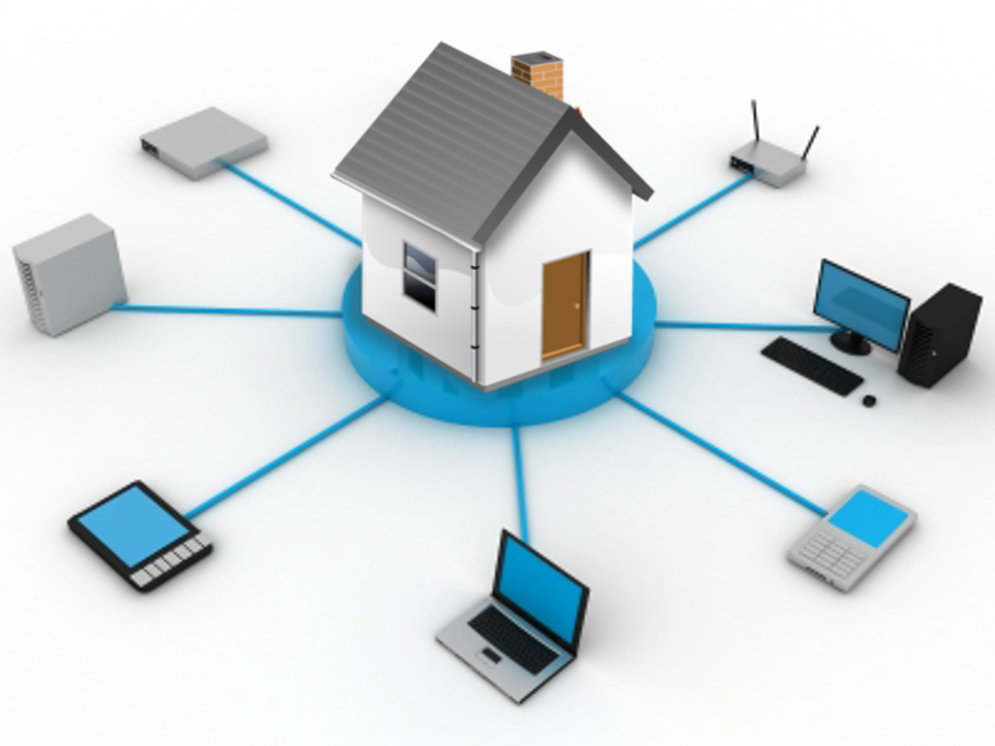
Introduction to Home Networking
Kelvin Cording
March 2019

Slide 2
Home Networking
Introduction
With increasingly widespread use of the internet together with the use of mobile devices, such as smartphone and tables, and applications such as home security systems, it is desirable to understand the general concepts of computer networking to gain the most out of these devices and facilities.
The objective of this series of presentations, together with practical demonstrations, is to provide an understanding of the concepts of computer networking, and how they may be applied. We will commence with the very basics for those with very limited knowledge of the concept and techniques involved.

Slide 3
Setup local home network with Network Attached Storage (NAS)
Using a Netgear DG 834G

Slide 4
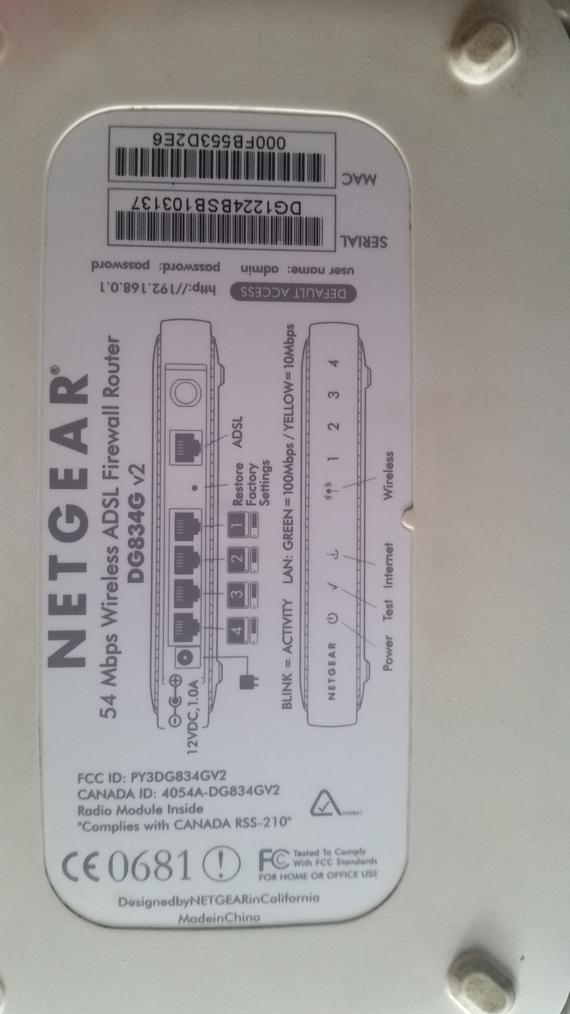
Using a Netgear DG 834G

Slide 5
Setup local home network with Network Attached Storage (NAS)
Using a Netgear DG 834G

Slide 6
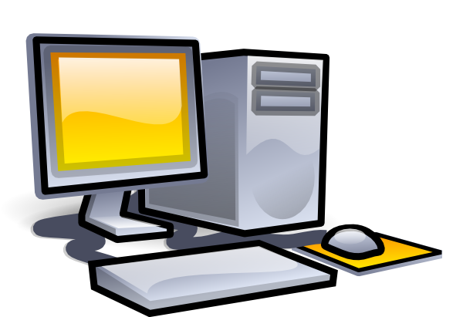
Start Project

Slide 7
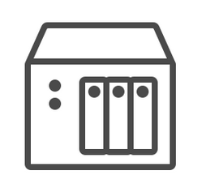
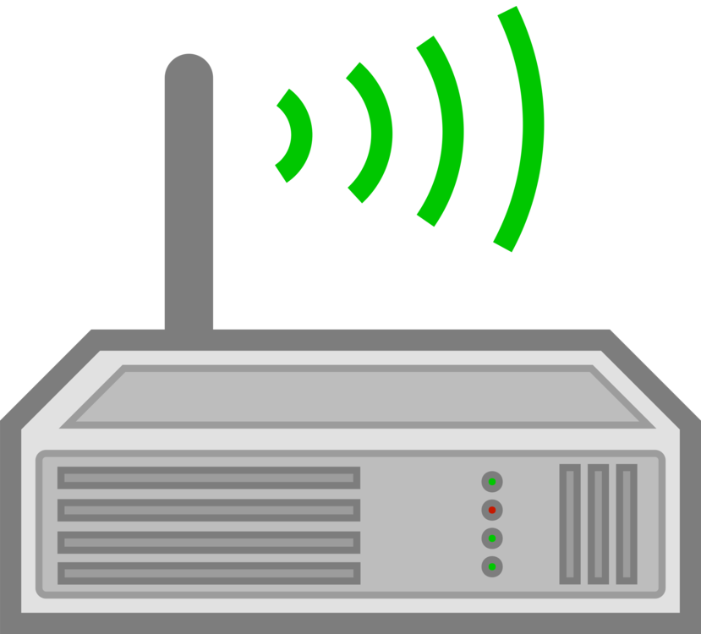
Finished Project

Slide 8
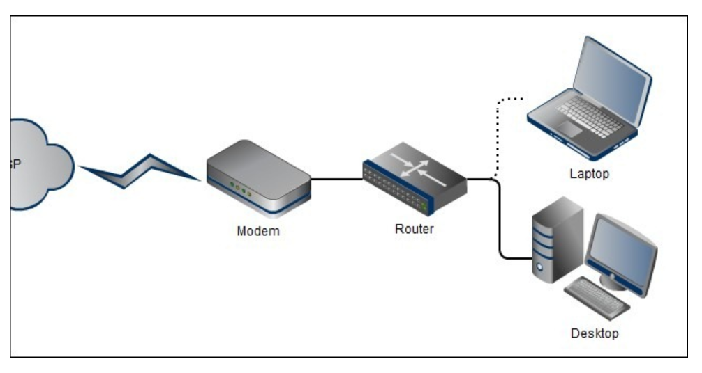
Modems and Routers are often combined in a single device often called a Modem/Router

Slide 9
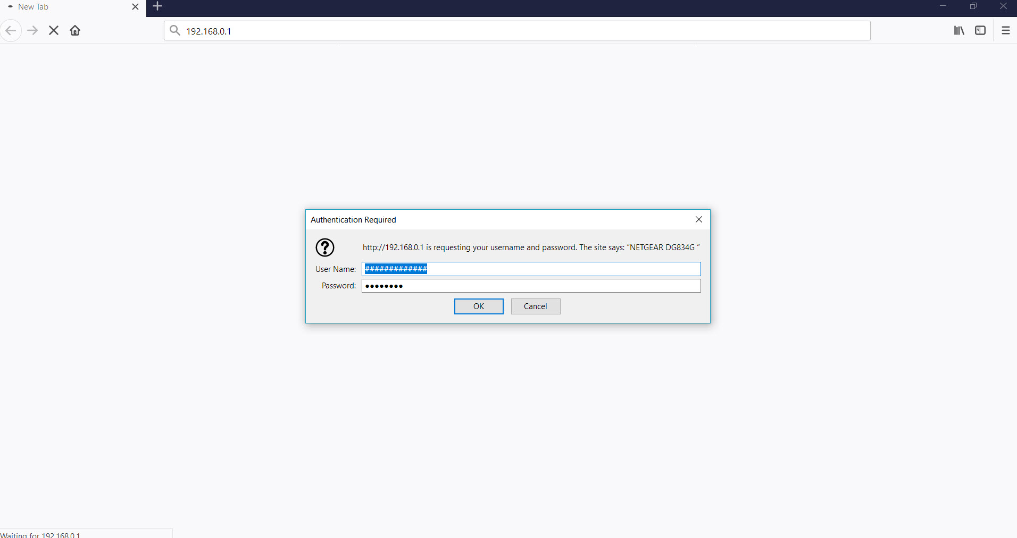

Slide 10
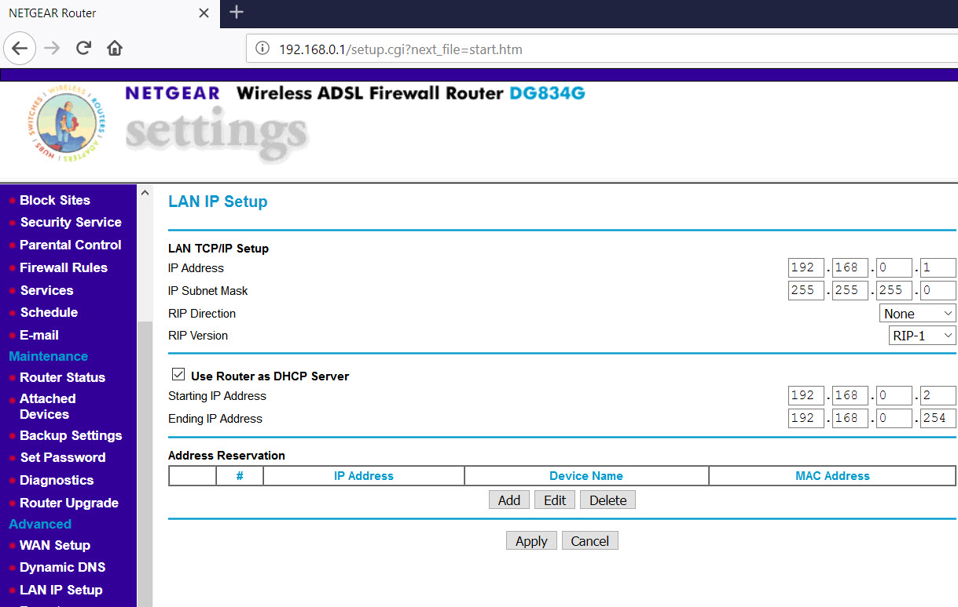

Slide 11
What is an IP Address

Slide 12
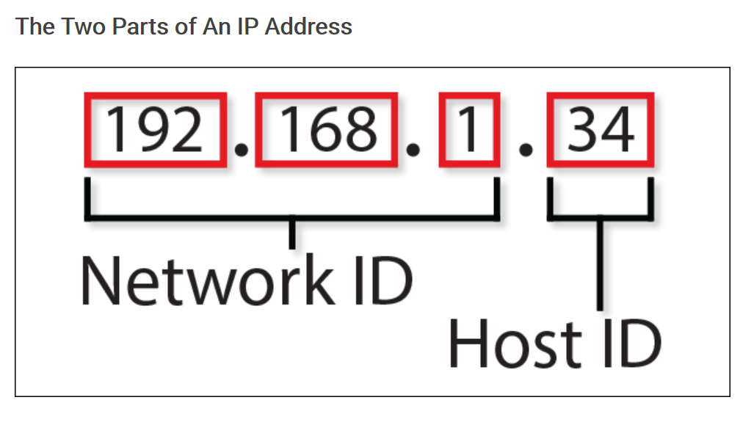
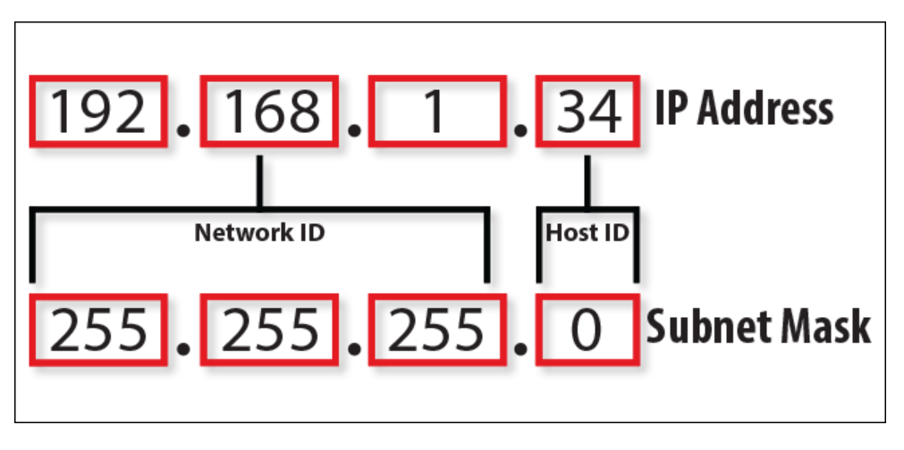
For home networks the subnet mask will almost always be 255.255.255.0

Slide 13
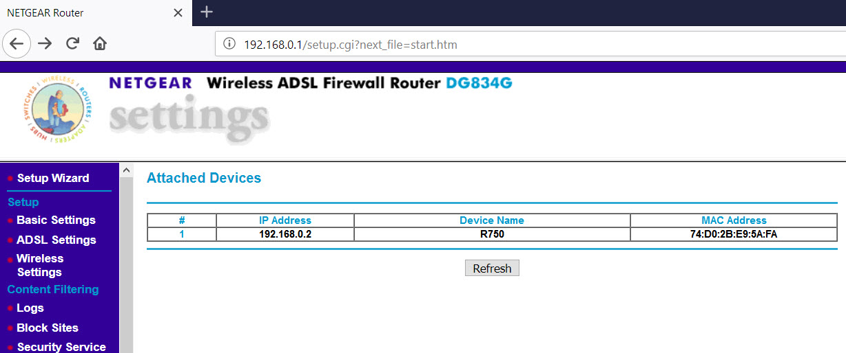
MAC Addresses

Slide 14
About MAC Addresses

Slide 15
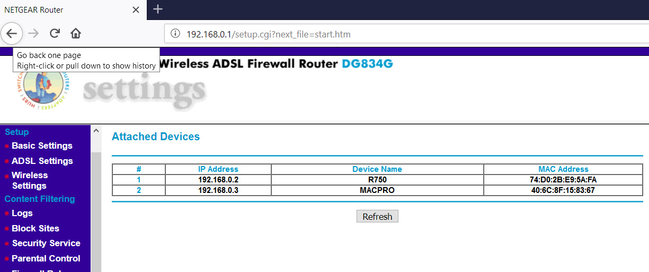

Slide 17
What Is DHCP

Slide 18
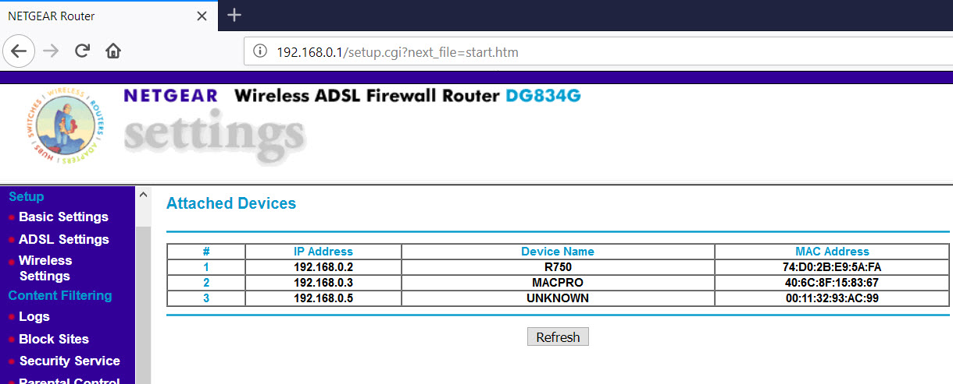

Slide 19
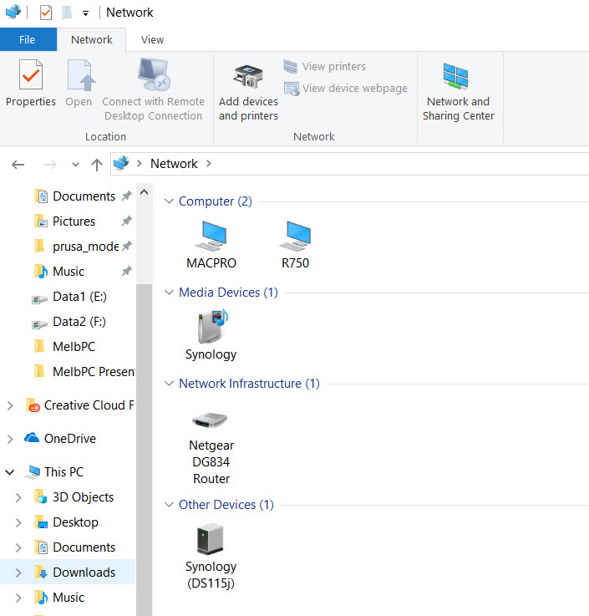

Slide 20
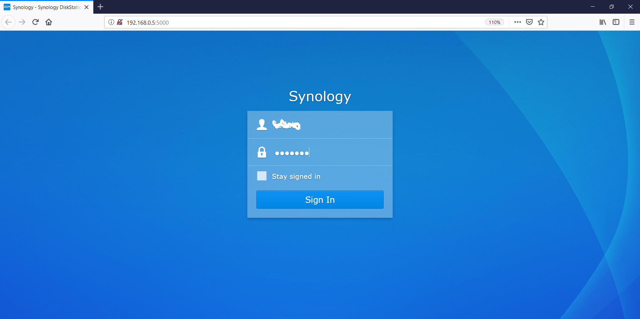

Slide 21
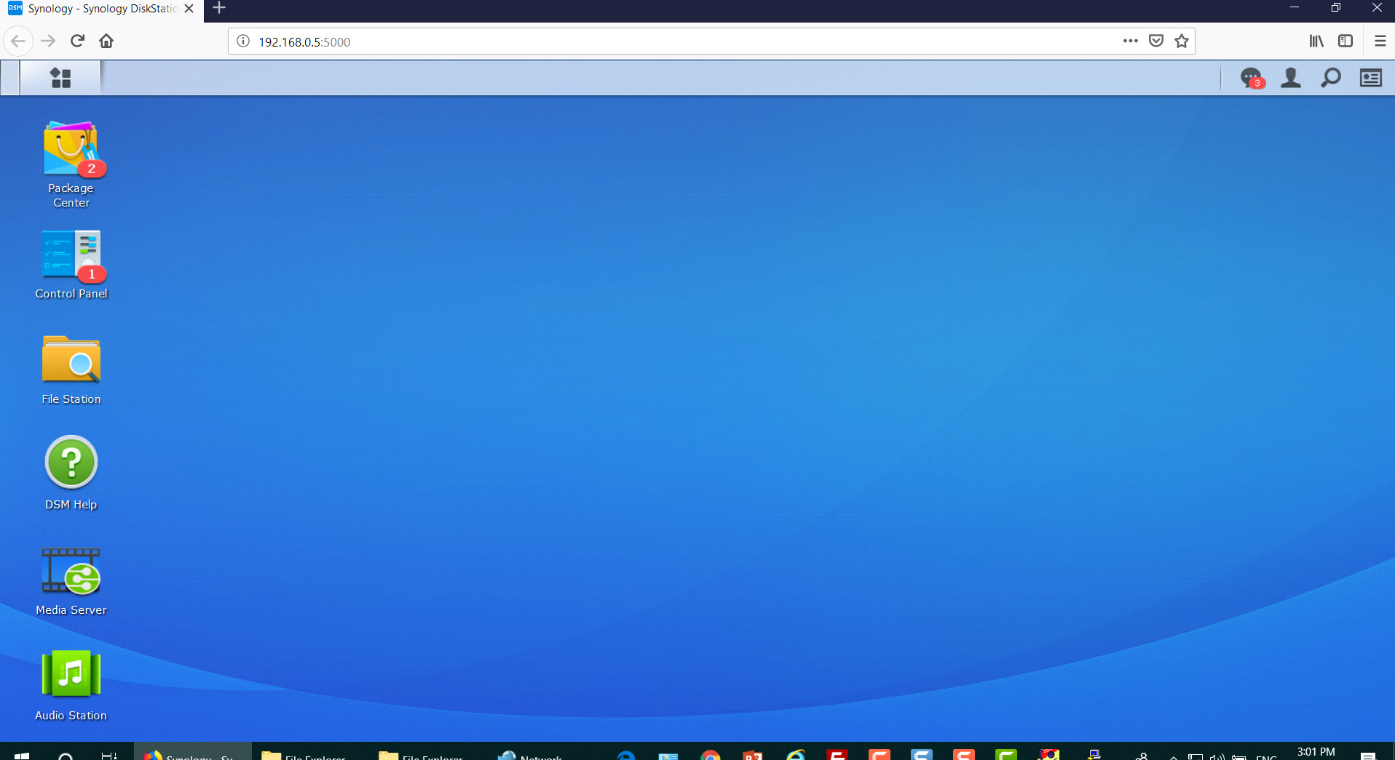

Slide 22
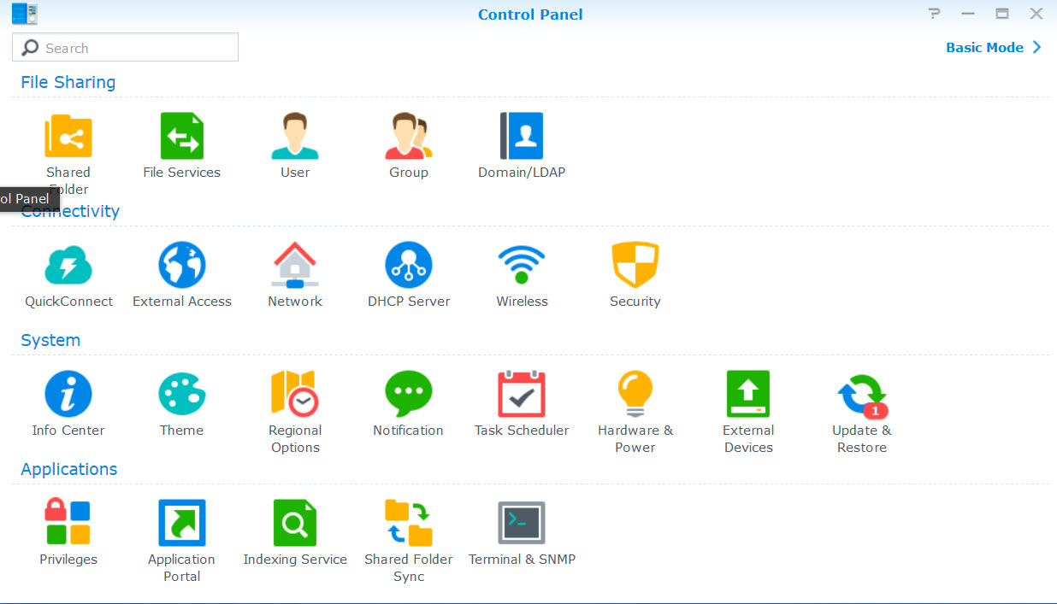

Slide 23
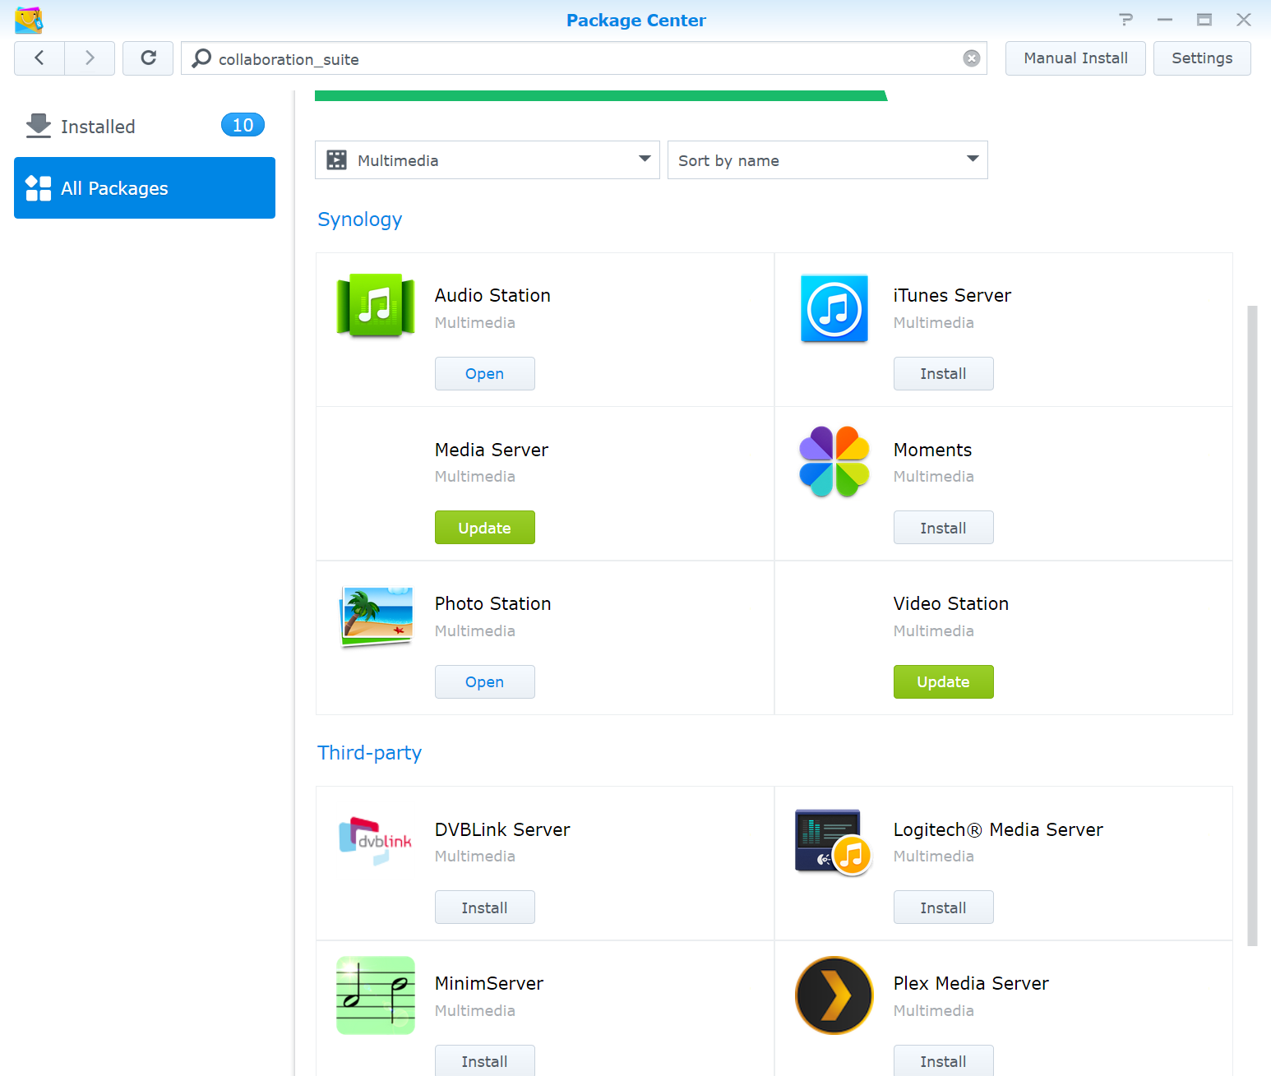
Synology and Third-party
Application Packages

