Slide 1
My N B N Plunge
History
Negotiation
Installation
PVR Demo
Dave Botherway May - 2019

Slide 2
Internet Connectivity History
1996 - Access via MelbPC Dial Up, at 56 K bits/sec
2002 - Pilot User on Optus Cable, at 20 M bits/sec
$50/m for 3 G Bytes Data + $30/m for Phone + Calls
2011 - Optus Price Increase, Speed -> 30 M b/s,
$55/m for 120 GB Data, Phone cost unchanged

Slide 3
Jan-2015 Special
Unlimited Data
Speed 30 Mb/s
Unlimited Calls ( including International Calls )
FETCH PVR box ( 30+ TV Channels)
PLUS negotiated . . . .
Speed to 100 Mbs
10% Discount (Mobile)
All up $81 / month

Slide 4
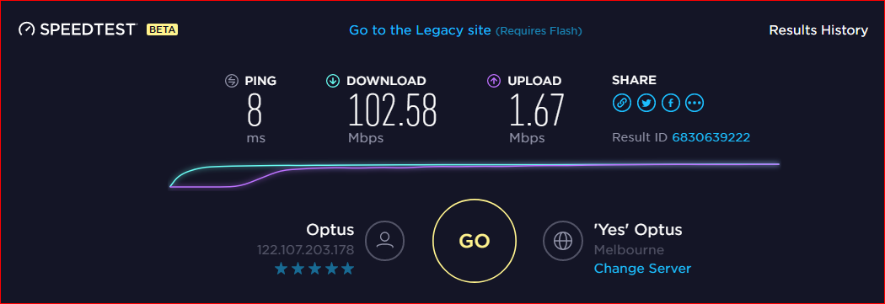
Internet Performance Testing
www.speedtest.net - February 2015

Slide 5
2015 NBN - MTM Launch
Australia wide Network, using new Fibre Optic technology
to totally replace existing Copper networks
Originally all FttP - Fibre to the Premises, expensive
Compromise - Multi Technology Mix
Add FttN - Fibre to the Node (in Street), or Fixed Radio
Takeover and use Telstra and Optus HFC cable networks

Slide 6
HFC – who does what ?
RSP Router
Retail Service Provider (RSP) to provide, unless BYO

Slide 7
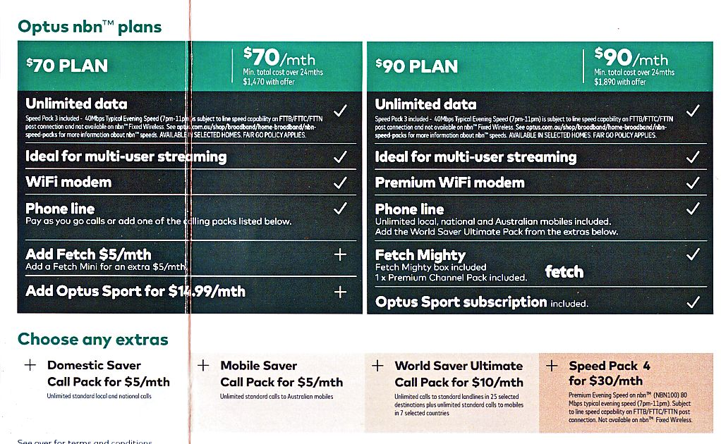
Optus Standard Offers - Nov-2017

Slide 8
Equivalent Optus NBN Offering
Status Quo (x 2015) – 100 Mbps, FetchTV etc at $81 / month
NBN Fetch Package - $90 / month
Unlimited data, only 50 M bps
Phone Line, Local + Mobile Calls
One Fetch Channel
Differences to existing deal
+ $30 /m to get 100 M bps, + $10 /m International Calls
No Mobile Phone discount
ie. $ 130 / m vs $ 81 / m
Strategy - Delay as long as possible (18 months ? )

Slide 9
Finally Nov-2018 “NBN Now Available” Cutoff: Nov-2019

Slide 10
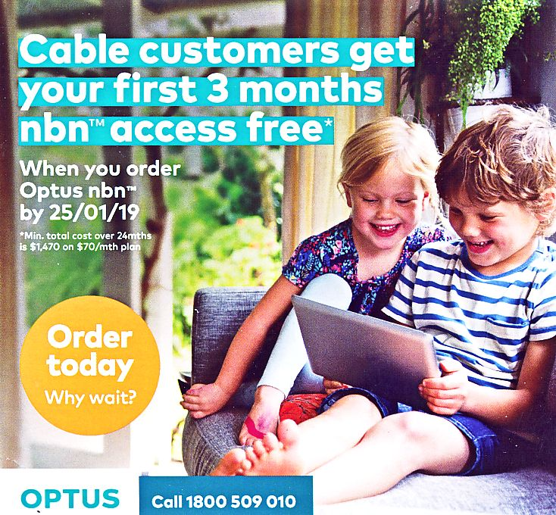
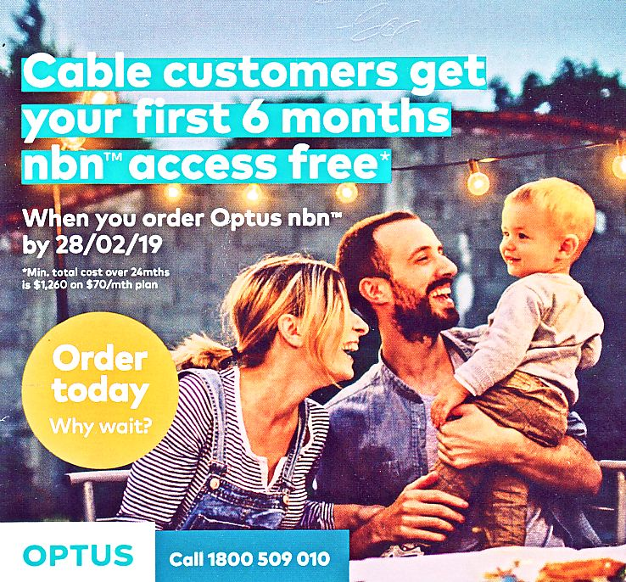
Early 2019 - Special Offers .. for existing Cable Customers

Slide 11
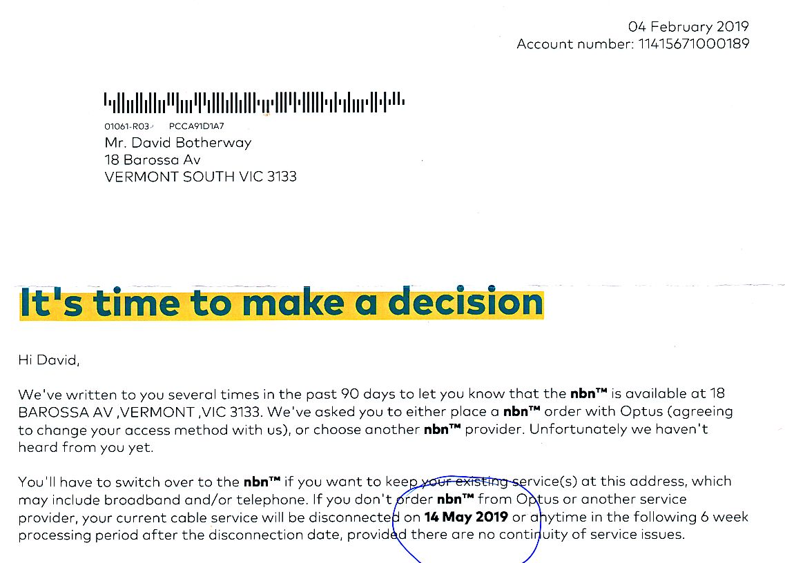
Ultimatum !

Slide 12
Second Negotiation – 26th Feb 2019
Tried Phone call – Too busy, so tried again 1 hour later …
30 minutes delay, transfer to Retention Dept, + 20 mins
Told them Ready-to-Order if 100 Mb/s available No-extra-Charge as per existing Pre-NBN setup . . .
“Need to speak to Mgr” . . Approved, asked for Email confirmation
Told me Email not needed – Conversation has been recorded Ref # NNMM, just call back once NBN service running !
Ordered ‘$90’ package - Fingers Crossed re 100 Mb/s !

Slide 13
Installation
Optus organised NBN Tech, agreed date/time between 8am & noon, Thu 21 March
Optus delivered Router 2 days prior . .
Tech arrived 10am, negotiated Cable path . . . .
NBN system running by noon - at ’50’ Mbps
Overnight delay re Phone # transfer (as expected)
Called Optus 4 days later, quoting Recording # and got ‘100’ Mbps after Modem Reset .
New Fetch PVR box – due after 2 weeks, nothing arrived so called them as a reminder ! !

Slide 14
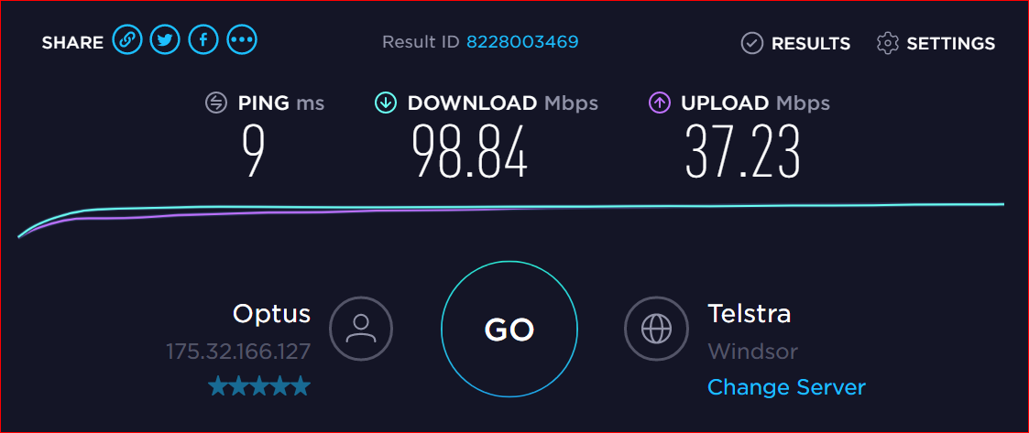
Result - 26 March 2019
NB. Cable was 103 DL, 1.6 UL

Slide 15
Costs . . . .
Initial Invoice received – part month, zero nett charge
First 6 months should also be Zero but trepidation re Speed Upgrade . . .
2nd Six months - should be only $80
13-24 months - full $90/m, thus average = $65/m
Only time will tell . . May need more phone calls

Slide 16
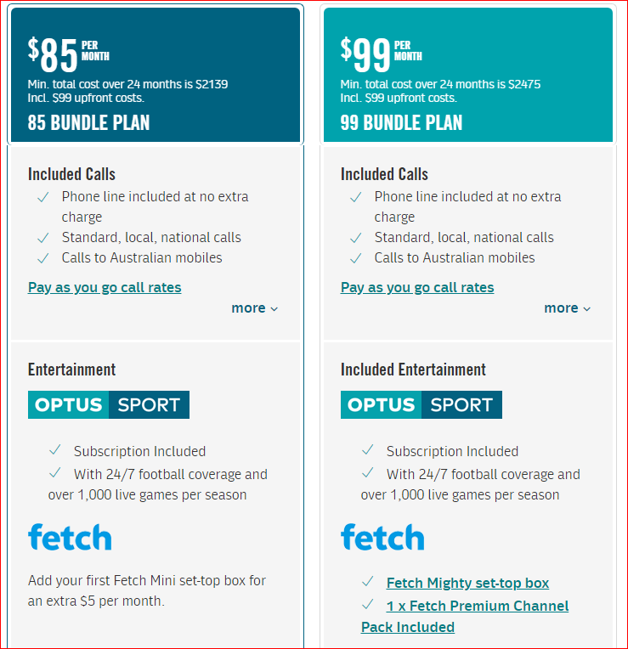
But . . 15 April 2019
$ 70 -> $ 85, with calls now included
$ 90 -> $ 99
and nothing extra . . .

Slide 17
Negotiation Summary
Have taken the Plunge . . $65 ? vs $130 List Price
Many Phone and Chat calls – usually 30+ min queues . .
Negotiation via Retention Dept was critical, Loyalty ! ( Telstra equivalent = “Disconnections Dept” )
NBN installed, all seems OK at 100 Mb/s
* * * Future invoices needed to confirm final offers
Key is . . Retention Dept negotiation . .

Slide 18
Fetch Mighty PVR . .
4 Tuners, 5G WiFi, 4K HDMI Output, 1 TB HDD Session Recordings, Phone Remote Control
No RF-Out, No Browser
Part of $90 Optus package - as addition / replacement ?
* includes Optus Sport and ‘one premium package’ ?
Yet to find if can keep and use old Gen2 box (Multi Room)
PVR also available from JB-HiFi, Harvey Norman etc $449 !

Slide 19
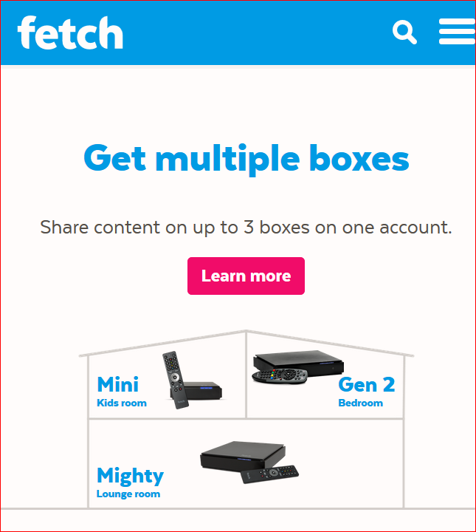
Fetch TV
Multi Room Setup

Slide 20
Questions

