Slide 1
From The Lap Top to 4K
David King
MHE 5.04.19

Slide 2
Topics for Today:
The ‘New” Lap Top - Show & Tell
Downloading HD Content
4K ULTRA HD
Some Videos
Associated Hardware

Slide 3
Tech Specs XPS 13 2-in-1 (Black)
Processor: 8th Generation Intel® Core™ i7-8500Y Processor (4M cache, up to 3.9 GHz)
OS: Windows 10 Pro 64-bit English
Memory: 16 GB LPDDR3 1866MH
Storage: 512GB PCIe Solid State Drive
Video Card: Intel® HD Graphics 615
Display: 13.3” QHD+ (3200 x 1800) InfinityEdge touch display, Black
Wireless: Intel® 8265 802.11ac 2x2 WiFi and Bluetooth
Pen: Dell Active Pen (PN556W)

Slide 4
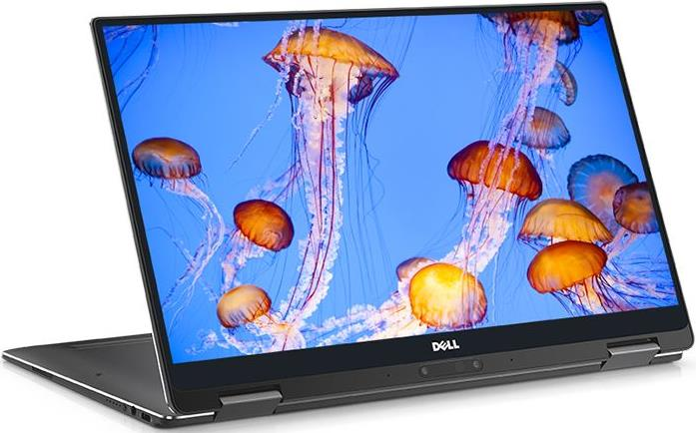

Slide 5
Ports & Slots
1. Speaker
2. Power Button
3. Micro SD Card Slot
4. USB-C 3.1 with Powershare, DC-In and Display Port
5. Noble Lock Slot
6. Thunderbolt™ 3 (4 lanes of PCI Express Gen 3)
with PowerShare, DC-In & Display Port
7. Headset jack
8. Battery gauge button and indicator

Slide 6
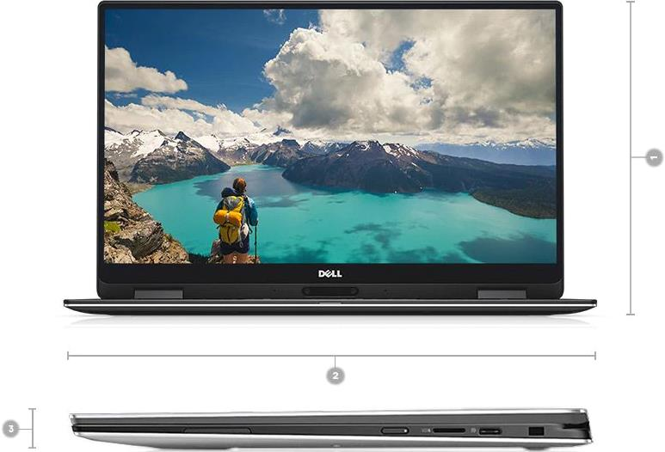
Dimensions & Weight
1. Depth: 199 mm ( 7.8 inches) | 2. Width: 304 mm ( 11.98 inches) | 3. Height: 8 - 13.7 mm (0.32- 0.54 inches) | 4. Weight: starting at 1.24 kg ( 2.7 pounds)*

Slide 7
Useful Applications:
4K Video Downloader
https://www.4kdownload.com/
Gihosoft TubeGet
https://www.gihosoft.com/
HTTrack Website Copier
https://www.httrack.com/

Slide 8
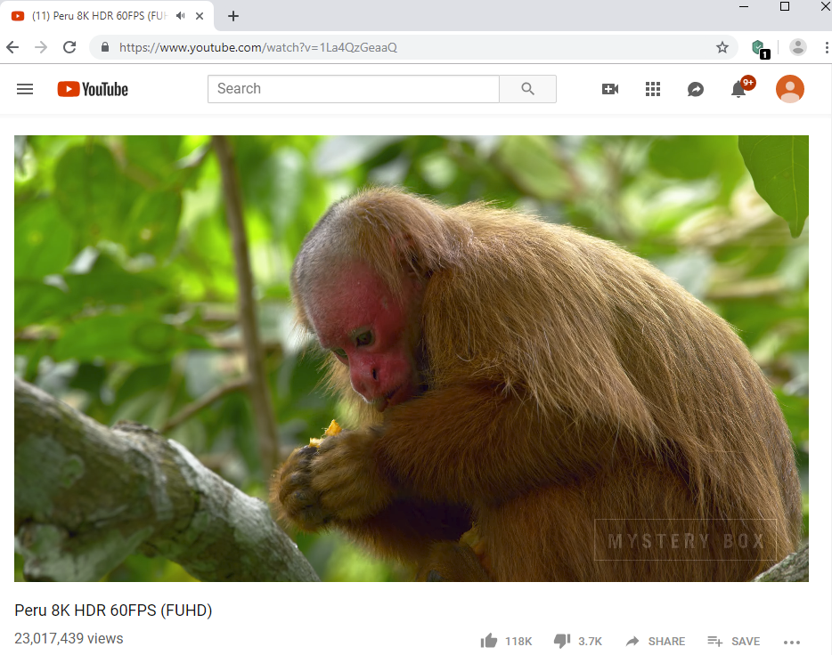
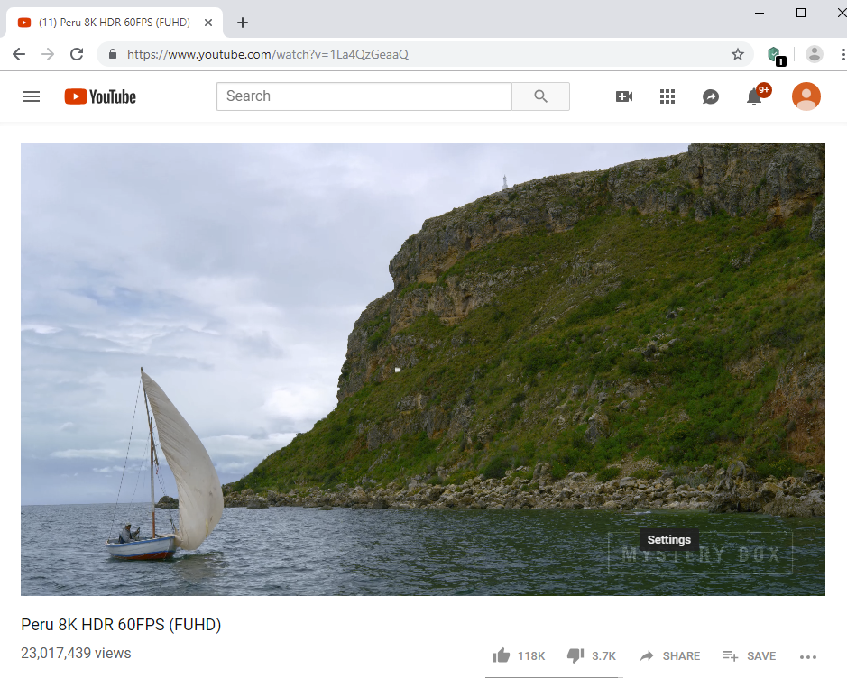

Slide 9
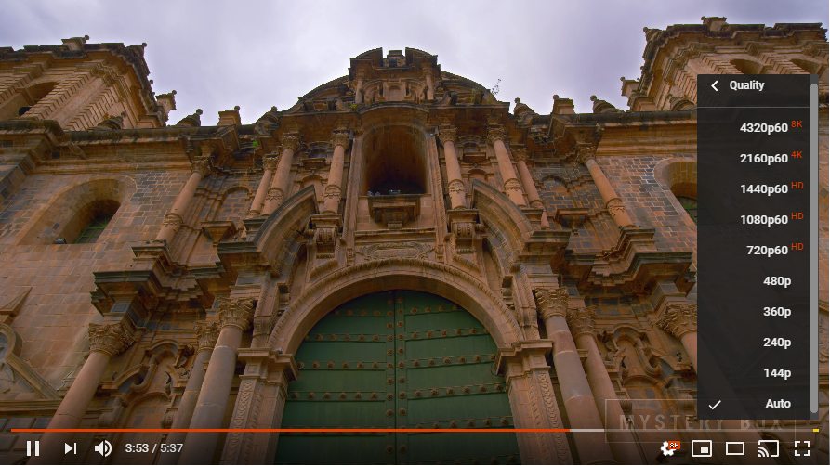

Slide 10
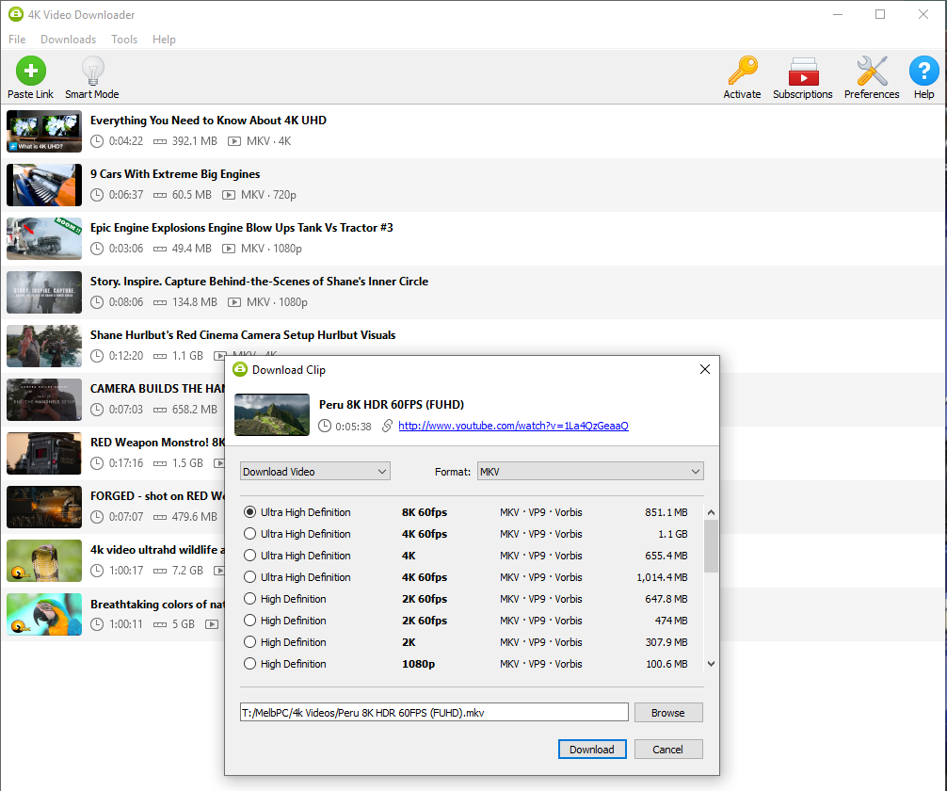

Slide 11
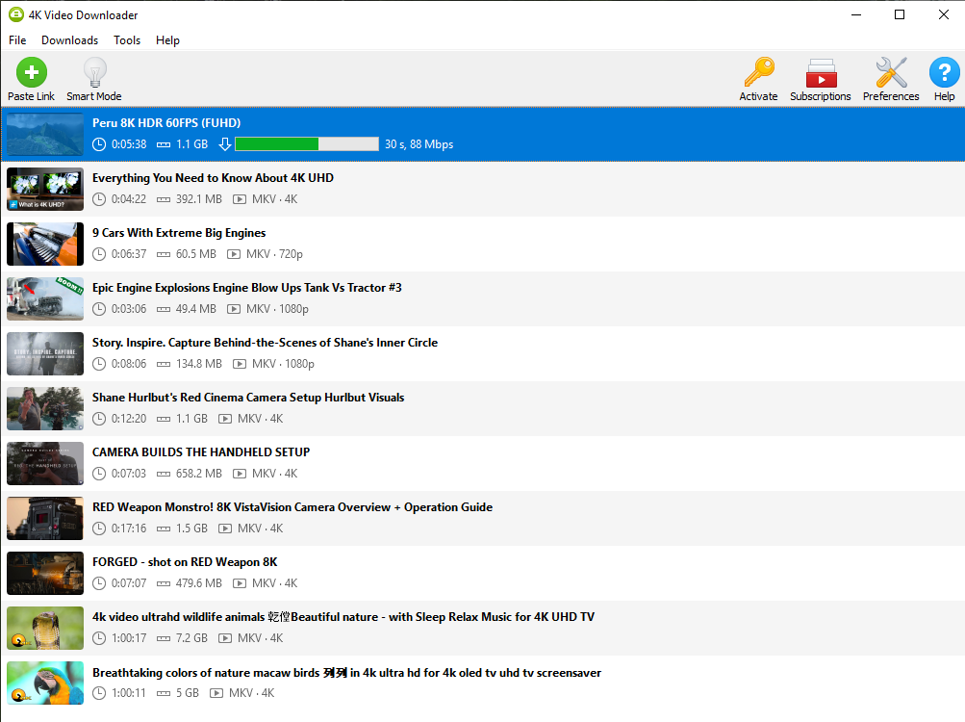

Slide 12
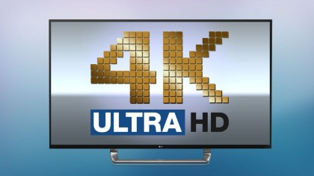
Click here to see “Everything you need to know about 4K UHD”

Slide 13
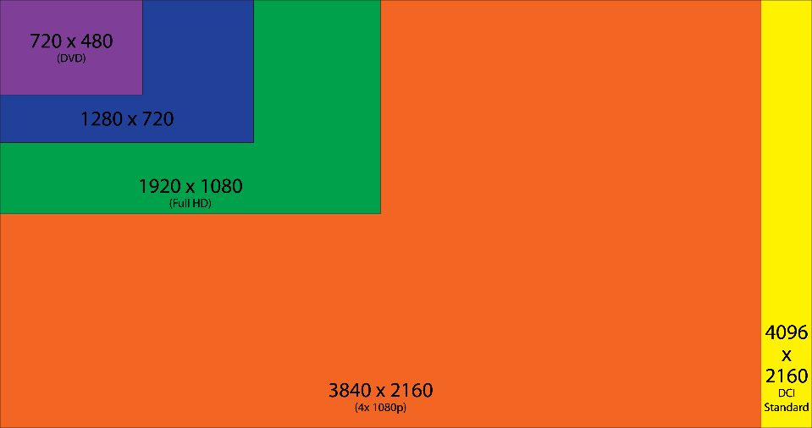

Slide 14
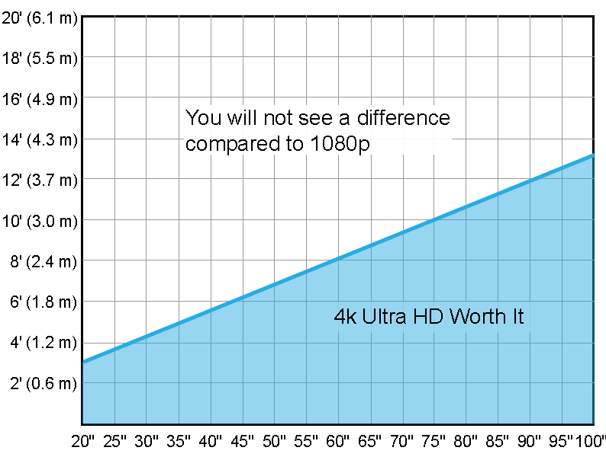

Slide 15
UHD Alliance is an industry group comprising the likes of Dolby, LG, Netflix, Panasonic, Samsung, Disney, Fox, Samsung, Warner Bros, Netflix, and DirectV., that was formed in an effort to establish a set of standards to herald a new era of ‘premium TV’. The group coined the term Ultra HD Premium.

Slide 16
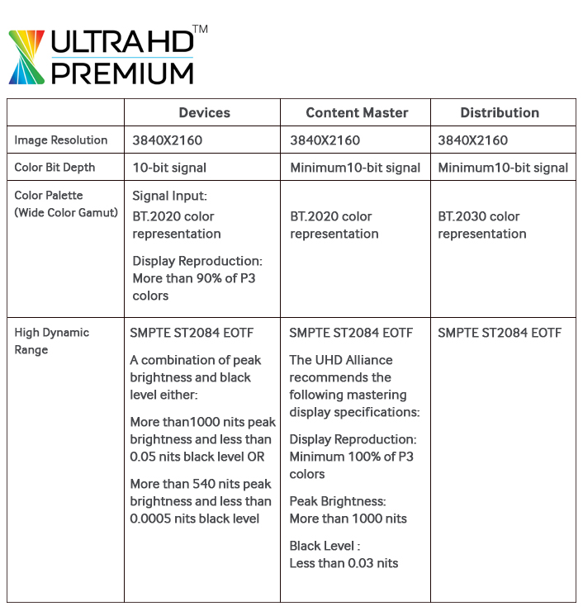

Slide 17
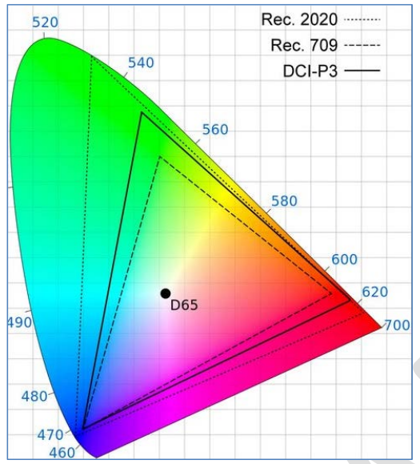
Wide Colour Gamut (WCG)

Slide 18
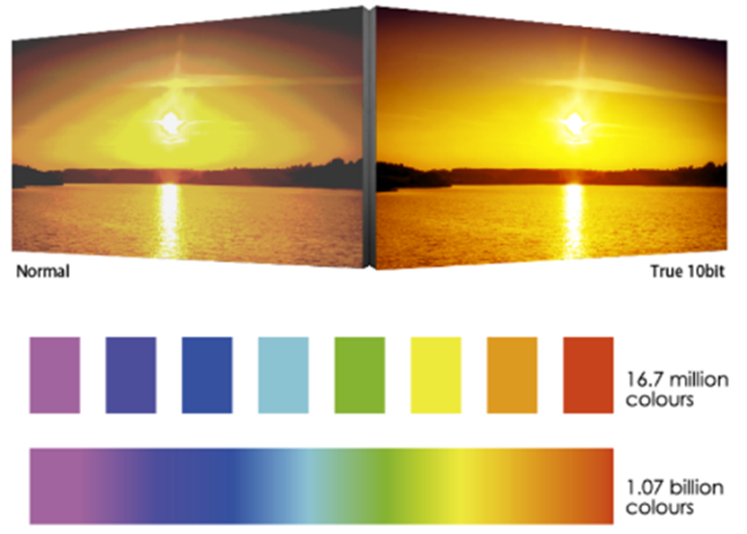
Colour Depth
HD is 8-bit, which means that a standard HD TV is able to display 256 shades each of red, green and blue, or 16,777,216 colors total combined.
UHD Premium increases this to 10-bits. Due to the way binary works, increasing this to 10-bit results in an exponential increase to 1,024 shades of the three primary colors. In total this means that 10-bit color offers a total of 1,073,741,824 colors.
.

Slide 19
HDR (High Dynamic Range)
Contrast

Slide 20
Shot On RED Weapon – 8K

Slide 21
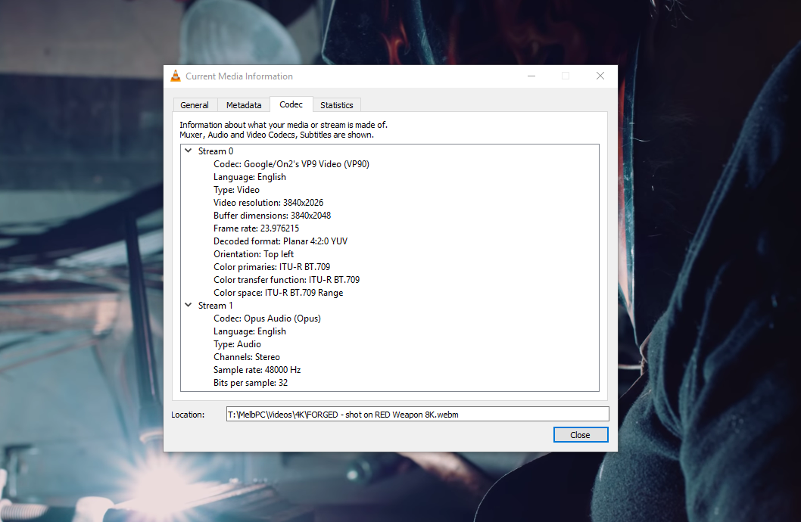

Slide 22
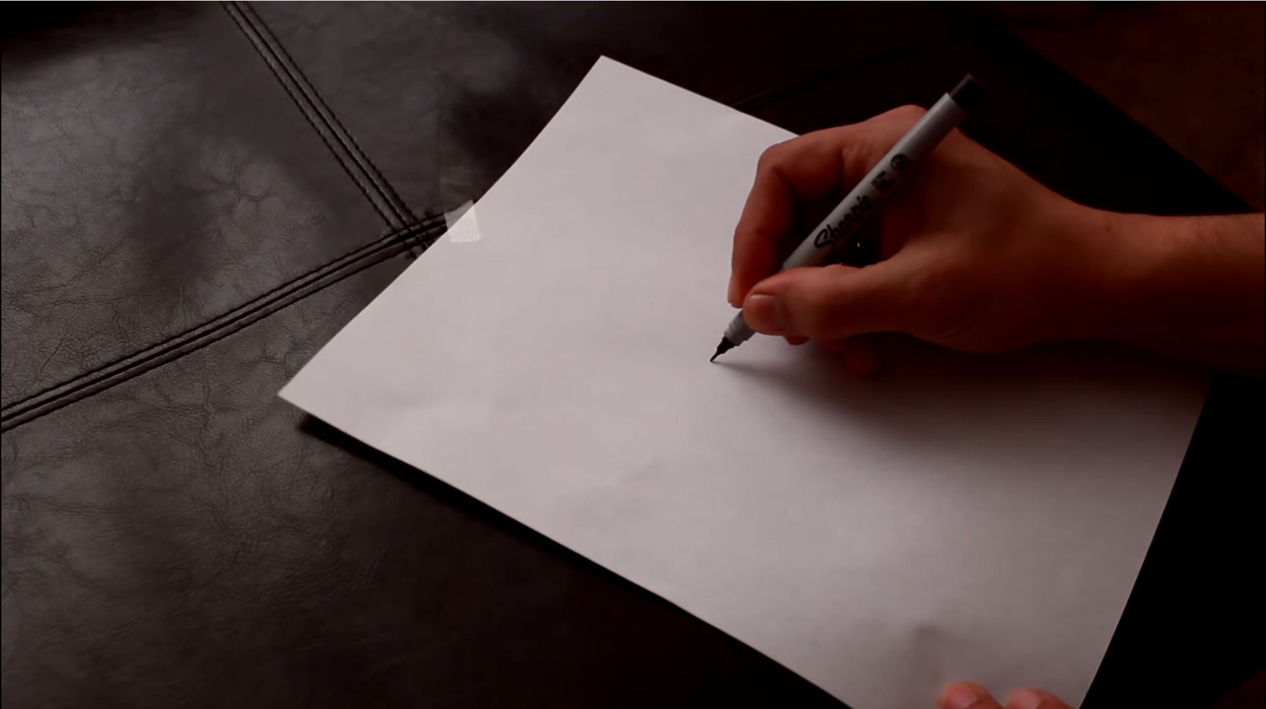
(here)

Slide 23
That’s All For Now Folks!
To Be Continued.

