Slide 1
3D Printer Models
Produced by Ken Holmes

Slide 2
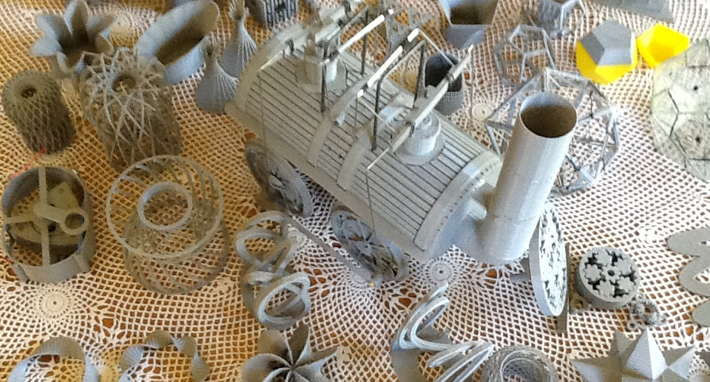

Slide 3
