Slide 1
Windows 10
Forgotten Features
Beast Dave Botherway June-2019

Slide 2
File History
& Timelines

Slide 3
Windows File History
Introduced in Windows 8
File changes auto-copied to an External Drive
Control Which Directories
Control How often (eg. Hourly)
Control How long kept (x Months, Forever)
Selective Restore

Slide 4
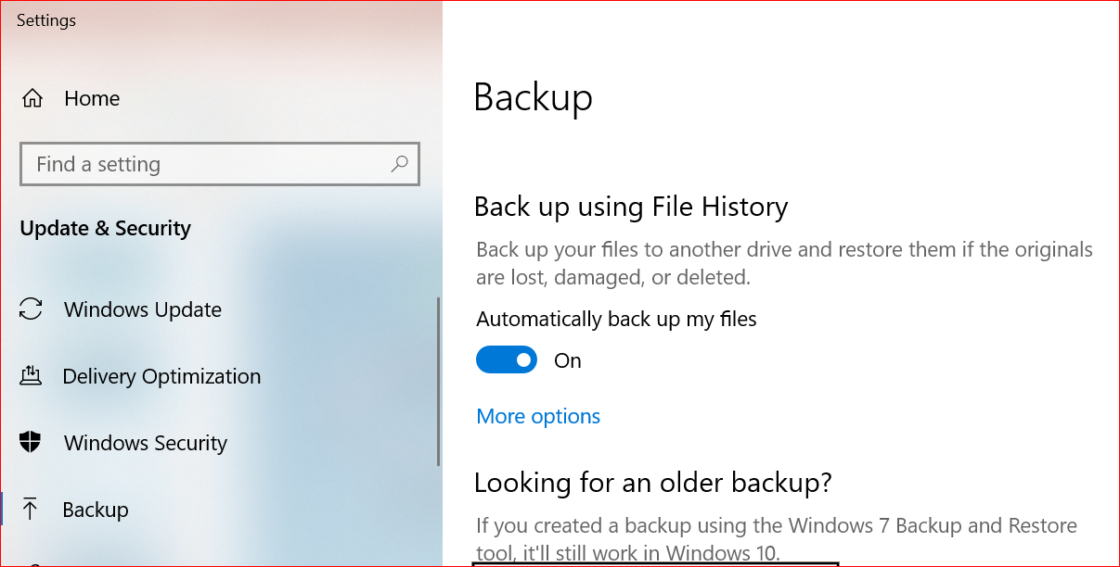
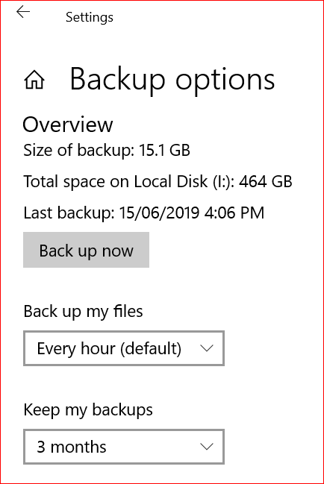
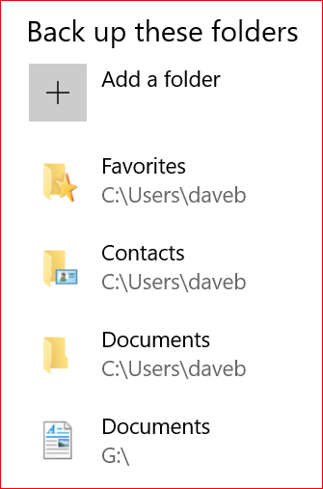
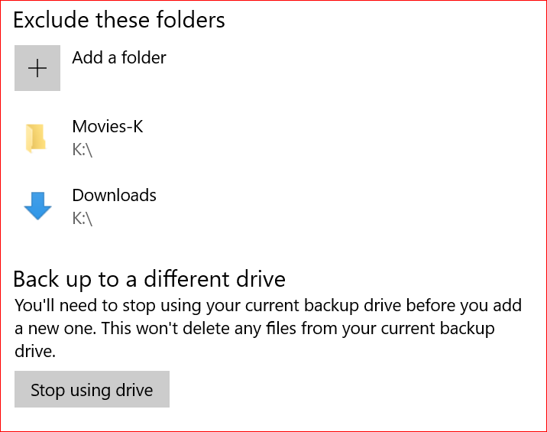

Slide 5
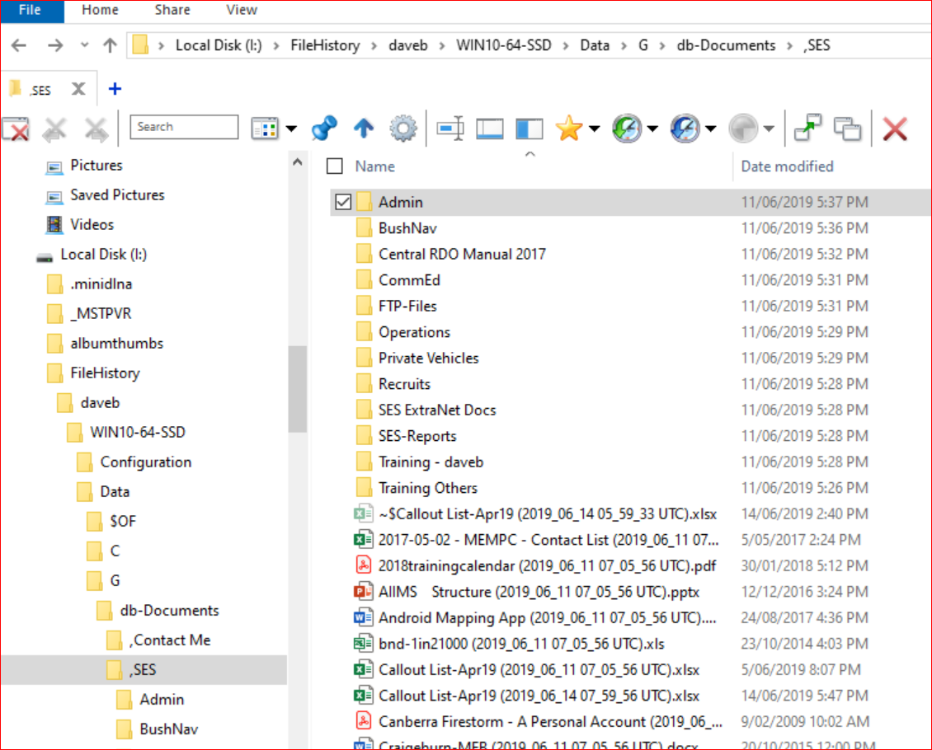
Recover using
File Explorer
Date/time
copied
added to File name

Slide 6
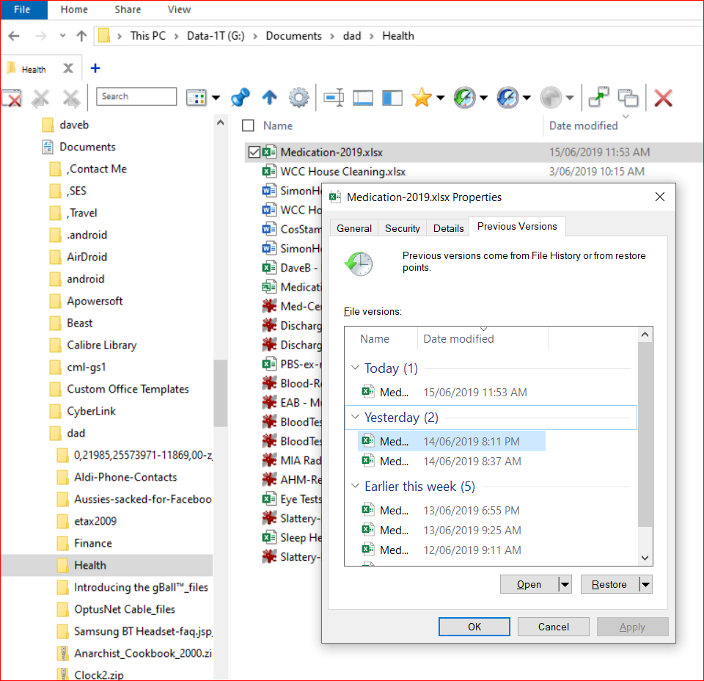
Find earlier Versions
Rt Click on
Item

Slide 7
File History
D e m o

Slide 8
Windows Timeline
Introduced in Win10 – 1803
  On by Default (Settings / Privacy / Activities)
Tracks Activity by Date
  Initially only MS functions (Office, Edge, Media Player)
  Being expanded as other developers use facility
  Can sync across multiple PCs using same User-ID
Very useful when Function / File name forgotten !

Slide 9
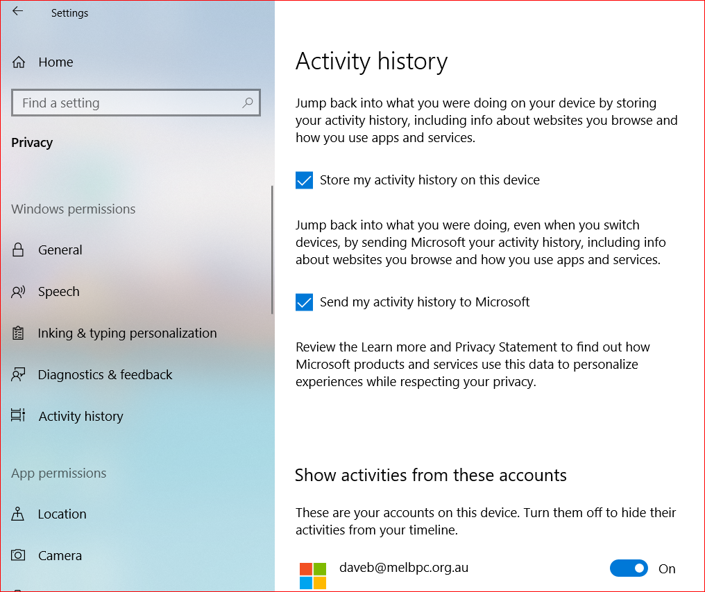

Slide 10
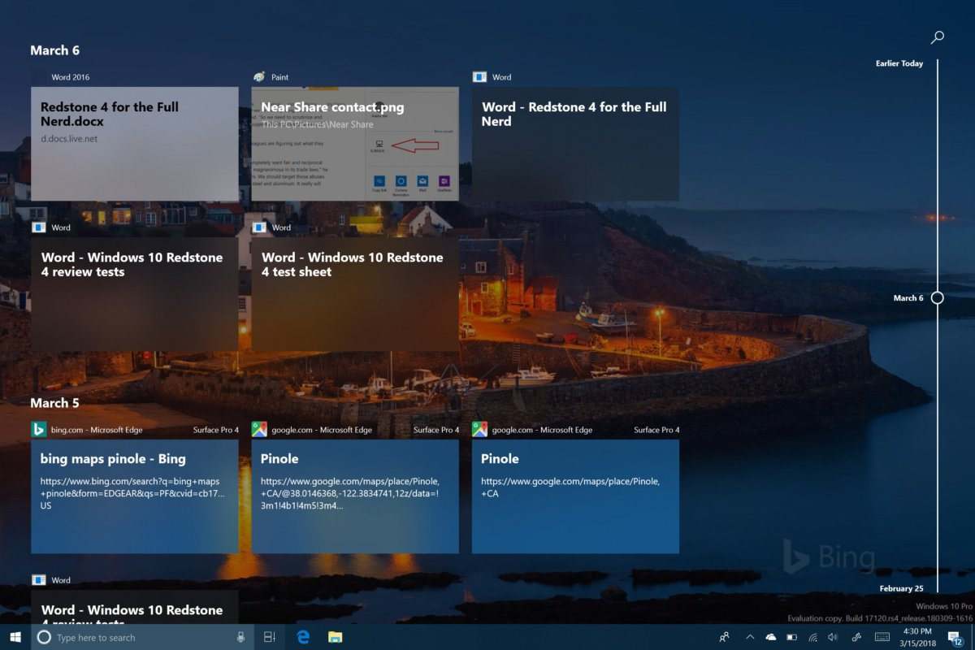

Slide 11
Windows Timeline
D e m o

Slide 12
Questions . . . .

