Slide 1
PDF FORM FILLING
Brian Heywood – August 2019

Slide 2
PDF FORM FILLING
THE old WAY
Get/Download the form
Print it
Manually fill & sign
Scan it
Share it
Costly & Messy

Slide 3
THE old WAY
Get/Download the form
Print it
Manually fill & sign
Scan it
Share it
A betta way
Get/Download the form
Fill & sign electronically
Share it
Costly & Messy
Much Cheaper & Neater

Slide 4
ADOBE ACROBAT READER DC
DC = Document Cloud
(Since 2015)
ACROBAT
READER DC

Slide 5
What is ‘Adobe Acrobat Reader DC’?
IT’s a free, stand-alone application that can BE useD to open, read, sign, print, annotate, search, share & ADD to – but not reformat ‘Existing ‘PDF’ documents’.
There are Windows, Android and iOS (APPLE) versions, SO PDF FILES CAN BE VIEWED AND SHARED ACROSS ALL OF YOUR DEVICES USING CLOUD STORAGE.
What is a PDF File?
The Portable Document Format (PDF) is a File Format developed by Adobe in the 1990s to present Documents, which may include images, text documents, forms, books, or any combination of these.
‘PDF’ was a proprietary format controlled by Adobe until it was released as an open standard in 2008.
‘PDF’ documents are independent of application software, hardware and operating systems.

Slide 6
WITH THE FREE ADOBE ACROBAT READER DC
YOU CAN:
Open, View, Read and Print PDF documents.
Using the ‘FILL & SIGN’ Tool - Complete ‘FLAT FORMS’ with instant access to your personal
autofill collection across desktop, web, and iPad devices.
Using the ‘COMMENT’ Tool - Suggest changes and add to existing PDF documents.
Sign up to ‘ADOBE DOCUMENT CLOUD’ for access to 2GB of FREE Cloud storage.
Using the ‘ADOBE DOCUMENT CLOUD’ – Get easy access to your saved PDFs across all of
your desktop, web, and mobile devices, and easily send and share PDFs with others.
From within the Reader - Access PDFs on other CLOUD STORAGE (e.g. Dropbox, OneDrive etc).

Slide 7
FILL & SIGN TOOL
TWO TYPES OF FORMS

Slide 8
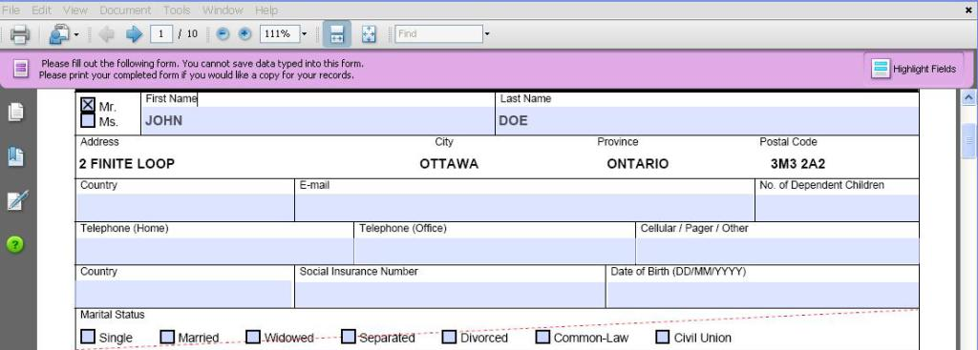
1. FILLABLE FORMS – with Interactive fields
Please fill out the following form. You cannot save data typed into this form.
Please print your completed form if you would like a copy for your records.
FILLABLE FORMS are usually filled-in and transmitted online with an option to view and print the final document.

Slide 9
Please fill out the following form. You cannot save data typed into this form.
Please print your completed form if you would like a copy for your records.

Slide 10
1. FILLABLE FORMS – with Interactive fields
Please fill out the following form. You cannot save data typed into this form.
Please print your completed form if you would like a copy for your records.
FILLABLE FORMS are usually filled-in and transmitted online with an option to view and print the final document.
NOTE: The FREE ‘Adobe Acrobat Reader DC’ cannot create FILLABLE FORMS

Slide 11
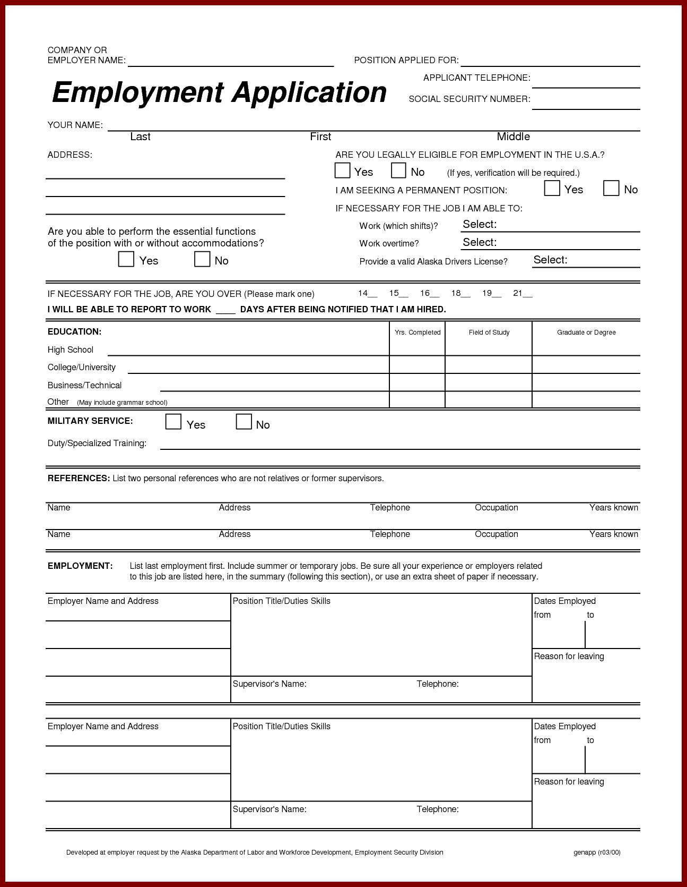
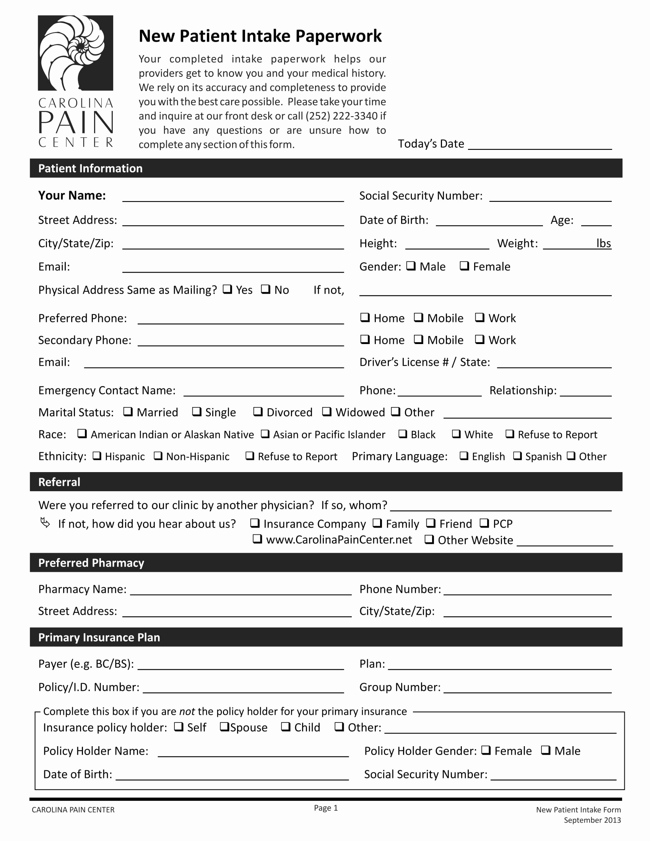
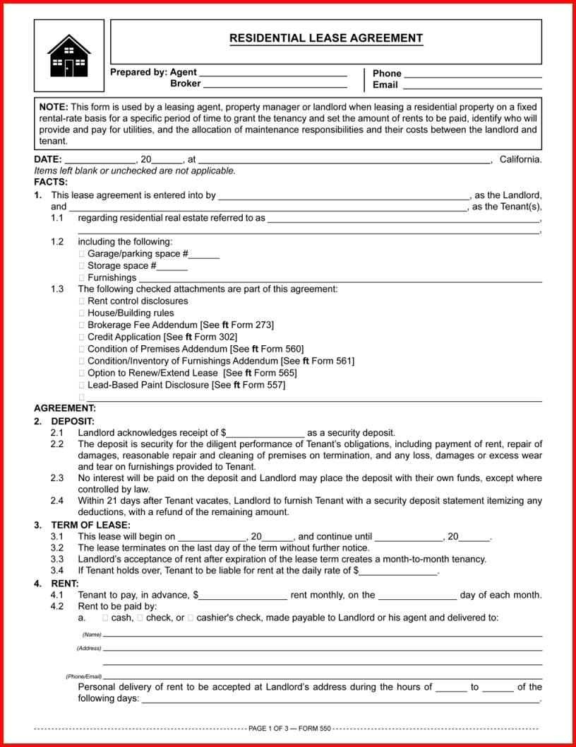
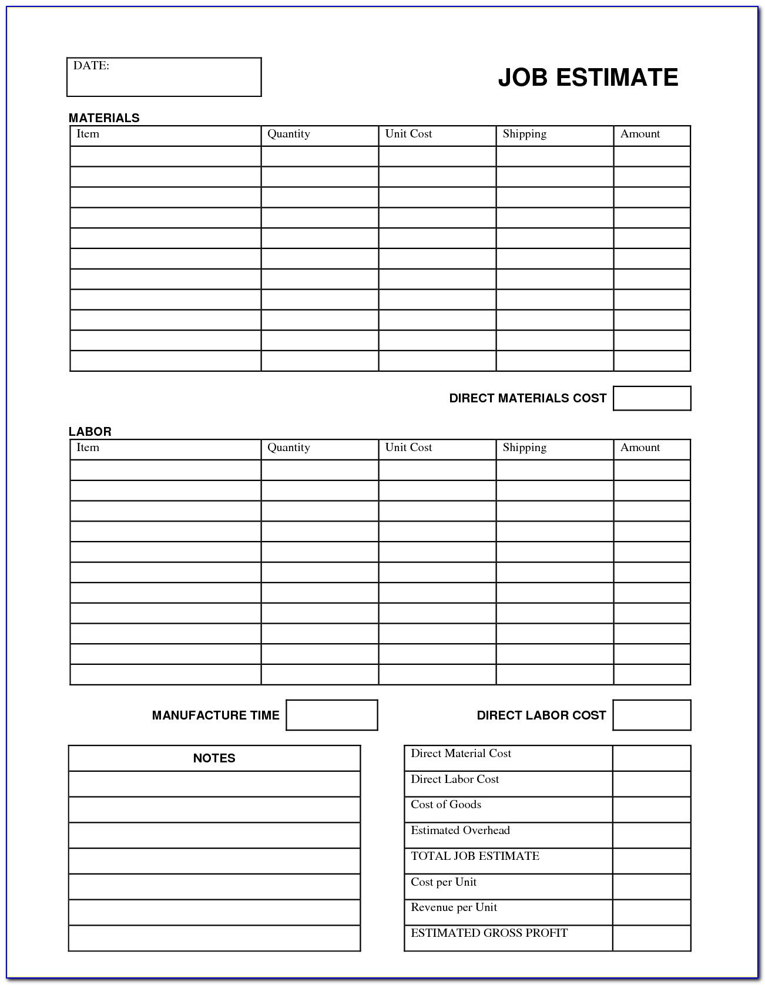
2. FLAT FORMS: - do not have interactive fields

Slide 12
2. FLAT FORMS: - do not have interactive fields

Slide 13
2. FLAT FORMS: - do not have interactive fields
- ONLINE FORMS NEED TO BE DOWNLOADED AND SAVED AS PDF
- HARD (Paper) COPIES of a form NEEDS TO BE SCANNED INTO PDF
- New ‘FLAT Forms’ CAN BE PRODUCED IN ‘WORD’ AND SAVED AS PDF

Slide 14
‘FILL & SIGN & ‘COMMENT’ TOOLS
WHY USE?
* TO PRODUCE NEATER (legible) DOCUMENTS.
* TO SAVE PAPER – No need to print.
* TO SAVE EXPENSIVE INK.
* TO SAVE TIME & EFFORT WITH REPEAT DOCUMENTS.

Slide 15
THANKS FOR LISTENING
ANY QUESTIONS

